Slide 1

Transforming your
Day Surgery Services Kit:
focus on cholecystectomy

Slide 2
NHS Institute
The Delivering Quality and Value team aims to discover how top performing healthcare organisations deliver the highest quality care with the best use of resources and find ways of spreading this successful practice

Slide 3
NHS Institute

Slide 4
The approach
Literature review of guidelines, best practice, case studies
Review of best practice in the UK and internationally
Visits to high and low performers
Co-production events
Focus On Series published
Processes
Behaviour
How care is
organised
What people
actually do
HRG pathway
Clinical care
Information
analysis
What care
is delivered
Measuring what
is being done

Slide 5
Cholecystectomy National
Day Case Rates 08/09
National average day case rate is 16%
Over a quarter of trusts have a day case rate of less than 5%
10% of trusts are doing no day cases at all
Only 1 trust is achieving BADS target of 60%

Slide 6
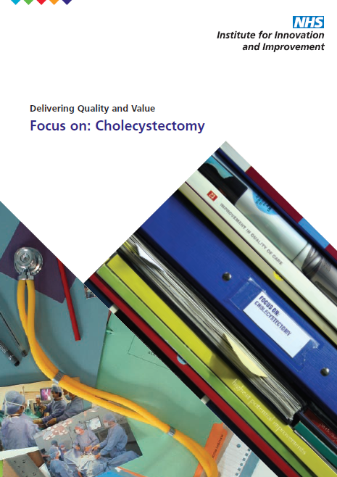
Focus on...

Slide 7
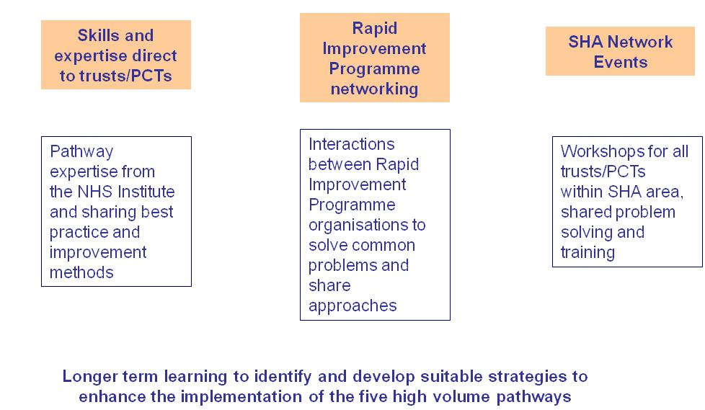
Rapid Improvement Programme

Slide 8
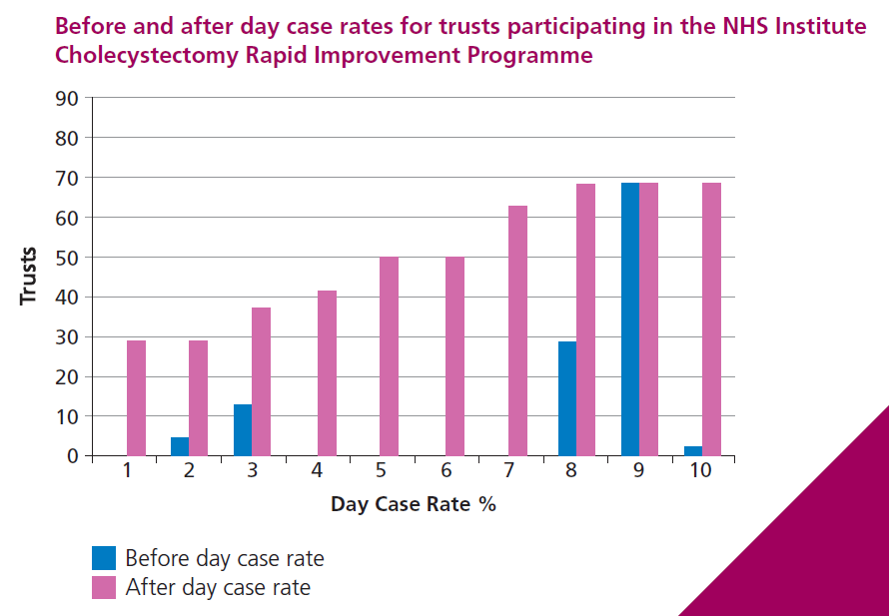
Rapid Improvement Results

Slide 9
Potential cost savings
The following savings can be made across NHS England:
£5 million alone if reduce LOS for choly by one day
A trust performing 300 cholecystectomies a year could expect to save approx £40,000 by increasing day case rates to 60%

Slide 10
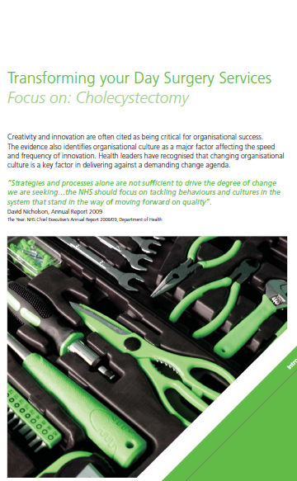

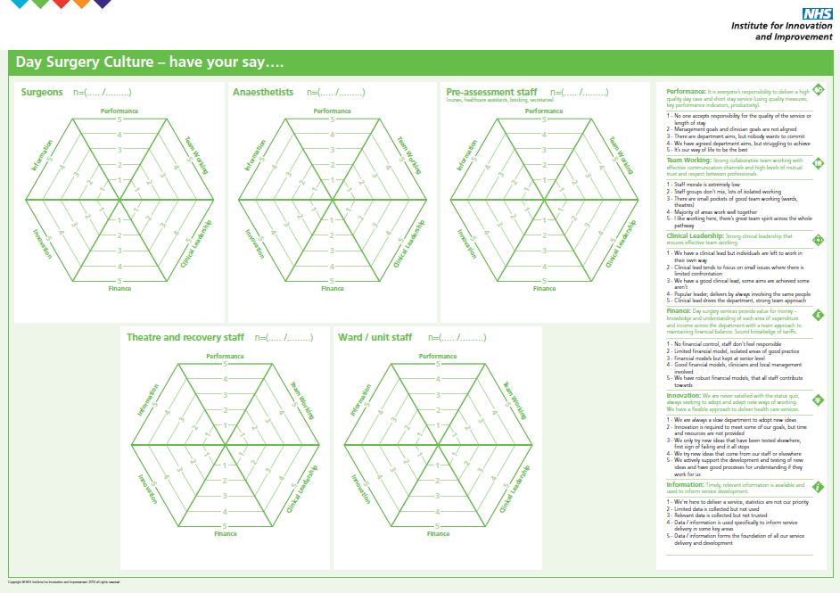
What’s included in the Kit
Culture Pack
Introduction
Surveys
Results Poster

Slide 11
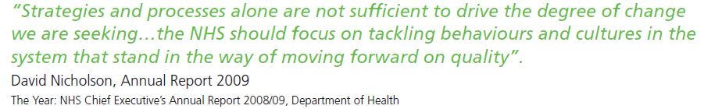
Culture – Why?

Slide 12
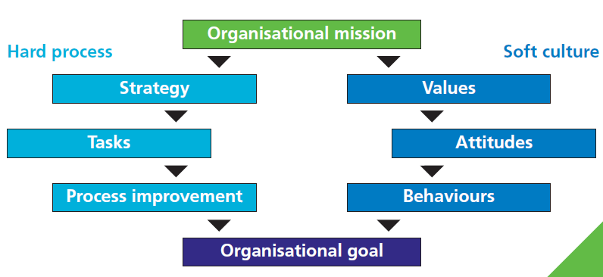
Culture – Why?

Slide 13
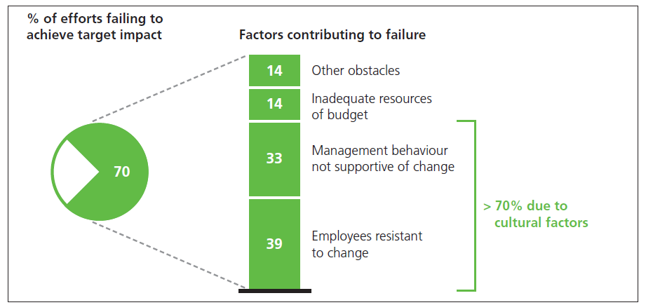
Culture – Why?

Slide 14
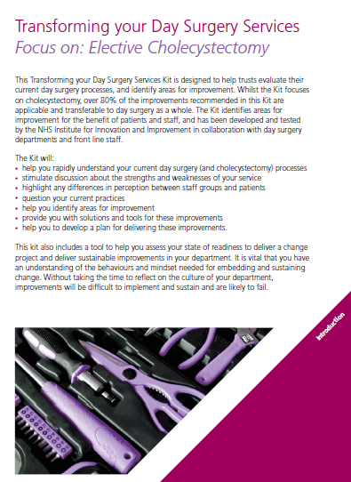
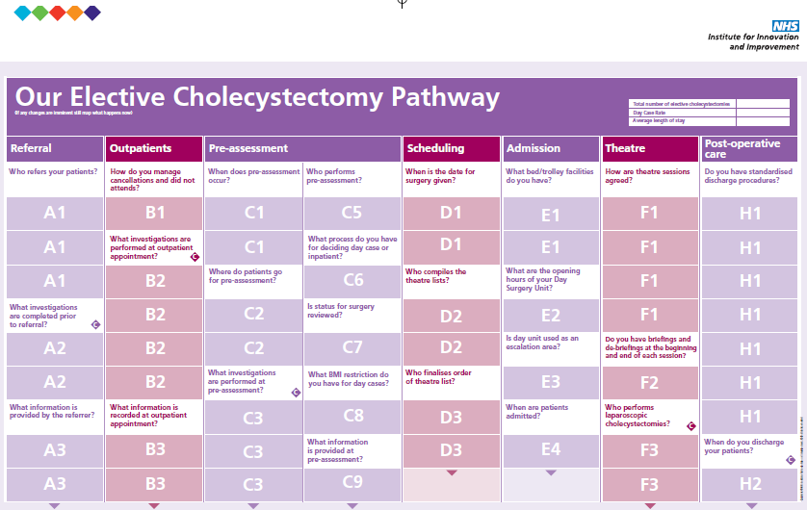

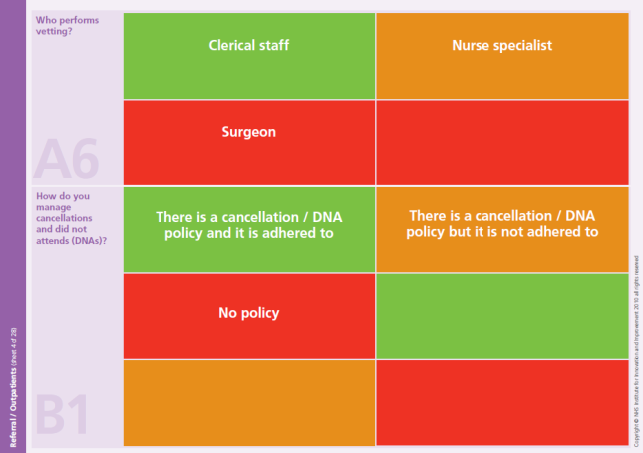
What’s included in the Kit
Process Pack
80% applicable to day surgery in general
Process Map
Process Map
Stickers
Plus templates
and action
plans

Slide 15
Emergency Cholecystectomy Kit to follow October 2010

Slide 16
Make it real

Slide 17
Surgical sub-specialisation
Barriers:
Risk of losing PAs
Lack UGI Consultants
Breaching targets – 18 weeks
Private practice

Slide 18
Specialisation Solutions
Long-term Improvement
Need to understand what you have now within surgery
Need a vision of ideal surgical model to meet service needs
Gap analysis of current to future state
Think outside of the box for your
solutions to achieve your goal

Slide 19

Defaulting
Pharmacy
Bed Managers
Pre-op assessment
Booking staff
Consultants
10%
Secretaries
Ward staff
Medical records
Coders

Slide 20
Pre-assessment
Sub – specialised
Pre-assessment
Consultant Surgeon Pre-assessment
Centralised
Pre-assessment
In-patient
Pre-assessment
Day surgery
Pre-assessment

Slide 21
Day Case Criteria
No age limit
Co-morbidity
Social support
Complexity of case
BMI ??
Distance
Discharge arran

Slide 22
Scheduling
Barriers:
Surgeons letting go / personal preference formula
Complex cases first whilst surgeon is ‘fresh’
List fillers mentality

Slide 23
Oxford Scheduling traffic light system

Slide 24
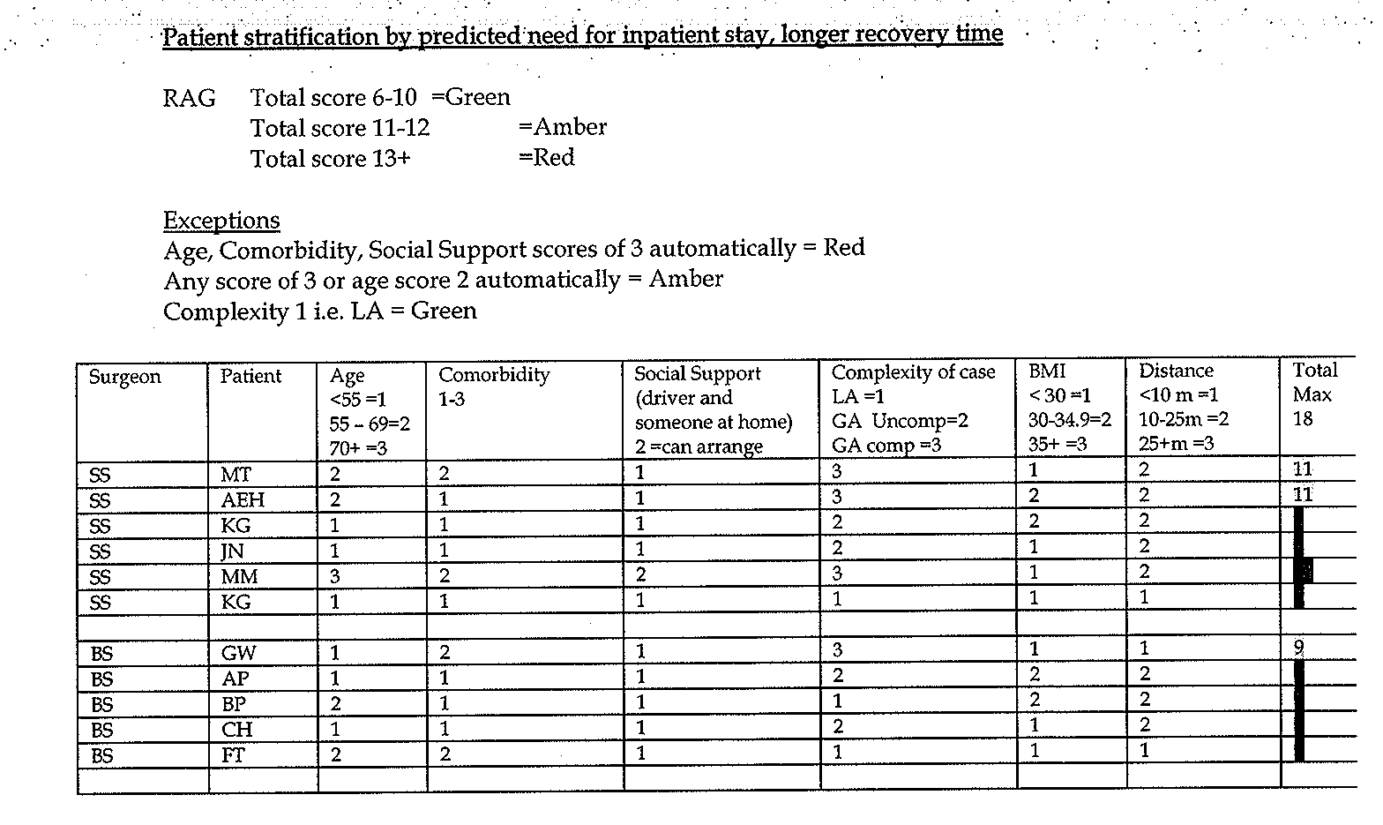

Slide 25
Experience shared
“Recipe” for guidance
No single best way
Common themes
Based on:
  good practice
  favourable outcomes
Notes:
PRINCIPLES OF ANAESTHETIC PROTOCOL

Slide 26
Recipe Components?
NSAIDS
Local anaesthesia
Antiemetic prophylaxis
iv Fluids
Minimal opioids
“Rescue” options
Notes:
ASK AUDIENCE TO LIST KEY COMPONENTS OF PROTOCOL, SUMMARY OF KEY POINTS

Slide 27
Nurse Led Discharge
Barriers:
No agreed discharge criteria / out of date / surgeon specific
Nurses believe its better for patients to stay overnight
Nursing lack of confidence and ‘training’
Surgeon letting go

Slide 28
Nurse Led Discharge
Solutions:
Written guidelines
  Observations stable
  Pain & PONV controlled
  Mobilising
  Tolerated fluids & diet
Audit how long it takes to achieve the above

Slide 29
Robust readmission process
  Not GP
  Surgical nurse, unit open 7 days a week
  SpR assessment more than likely required
  Audit the post-op contact and outcomes
  Expect less than 3% return rate

Slide 30
Come and visit us at
    Stand 51
    www.institute.nhs.uk

