Slide 1
Our Previous Presidents

Slide 2
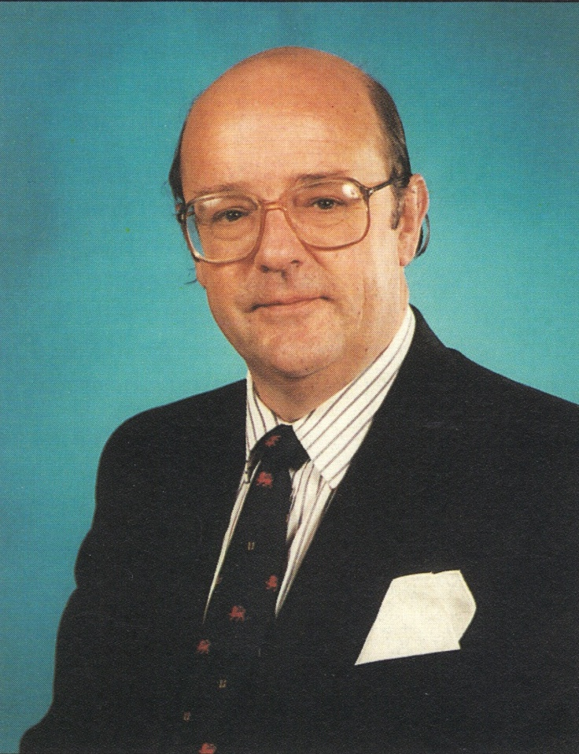
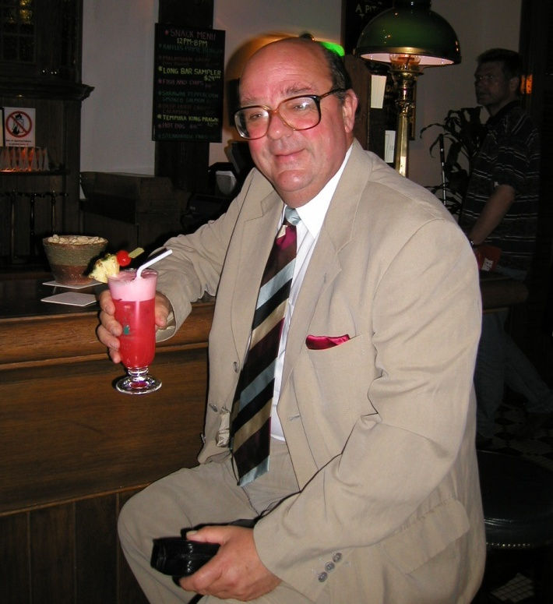
1990 -1992 Paul Jarrett

Slide 4
British Association of Day Surgery 1989 - 2010

Slide 5
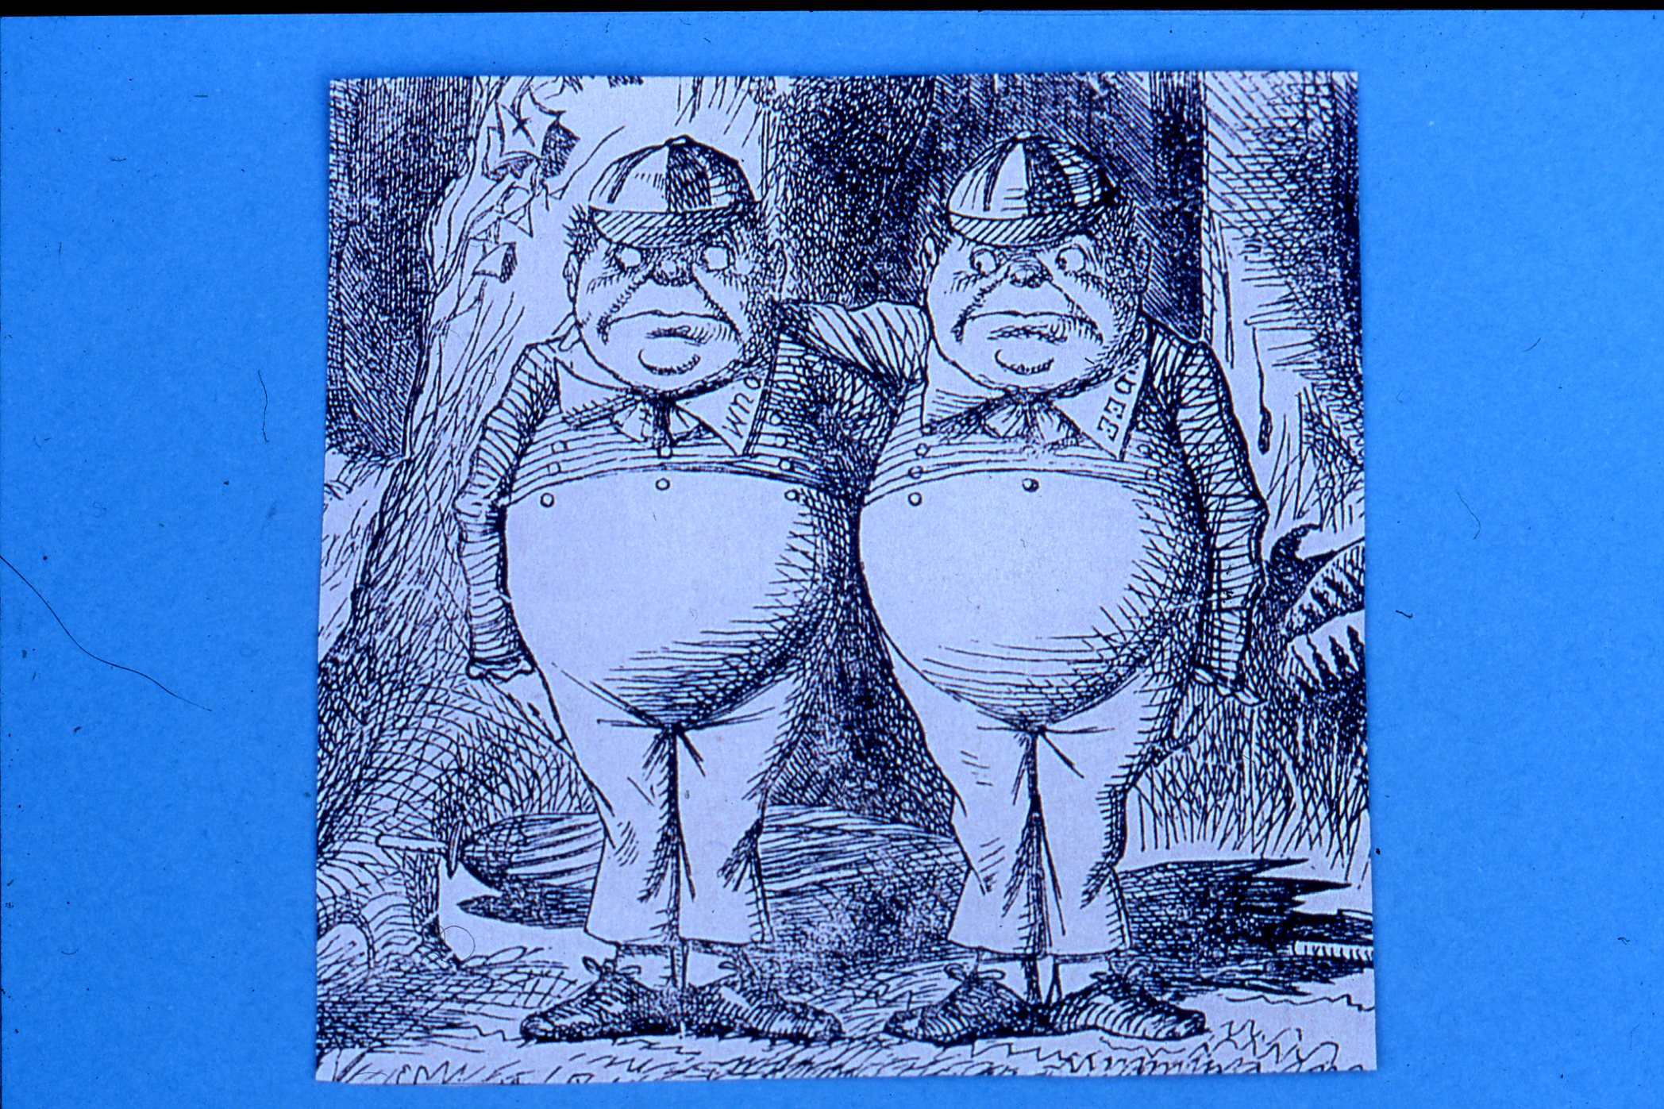

Slide 11
Meeting Stafford Hotel, 22-23 April, 1989
Present:
Mr Paul Jarrett Consultant Surgeon, Kingston
Dr Tom Ogg Consultant Anaesthetist, Cambridge
Dr Tony Davenport Consultant Anaesthetist, Northwick Park
Dr Jean Millar Consultant Anaesthetist, Oxford
Mrs Sarah Penn Nursing Sister, Barnet
Mr Peter Simpson Regional Medical Officer, Liverpool
Mr Chris Ward Consultant Plastic Surgeon, London
Apologies:
Mr Brendan Devlin Consultant Surgeon, North Tees
Prof. Sir Miles Irvin Professor of Surgery, Salford

Slide 12
First BADS Committee, 1989
Chairman Paul Jarrett
Chairman Elect Tom Ogg
Secretary Jean Millar
Editor Tony Davenport
Members Sarah Penn
Peter Simpson
Chris Ward

Slide 29
Our Previous Presidents

Slide 30
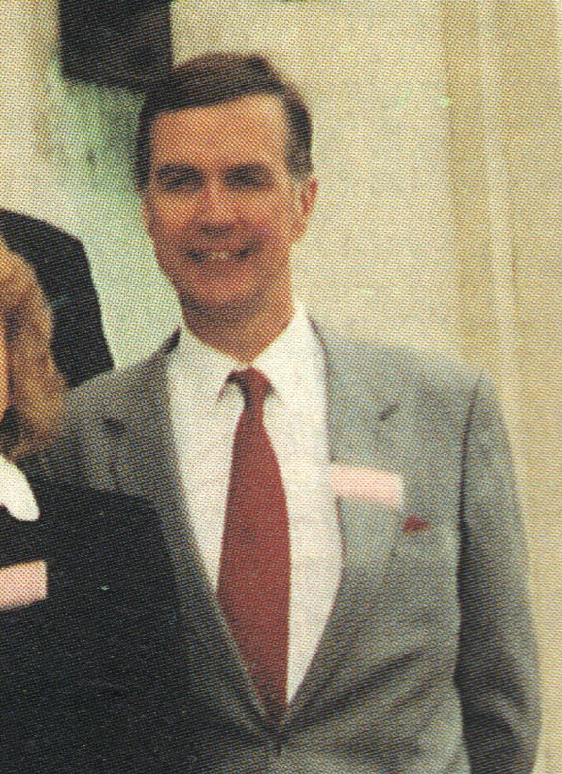
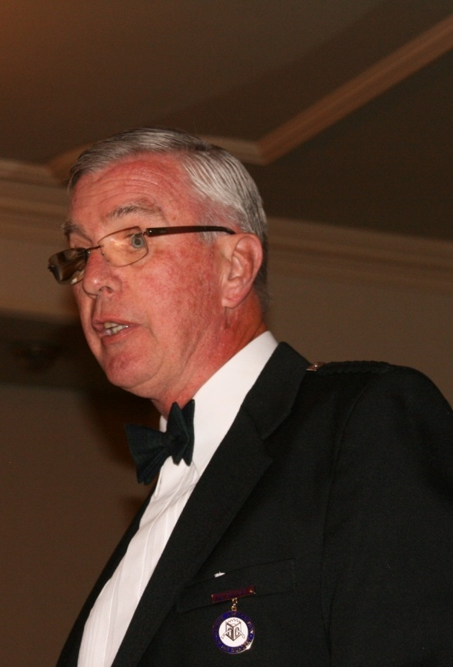
1992 -1994 Tom Ogg

Slide 31
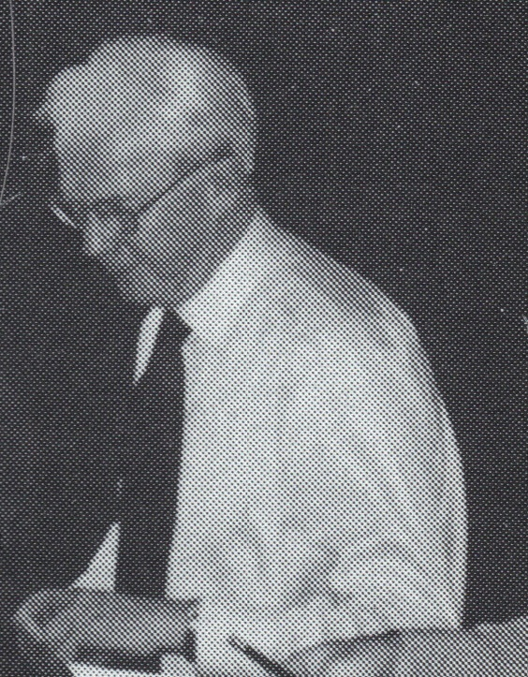
1994 -1996 Brendan Devlin

Slide 32
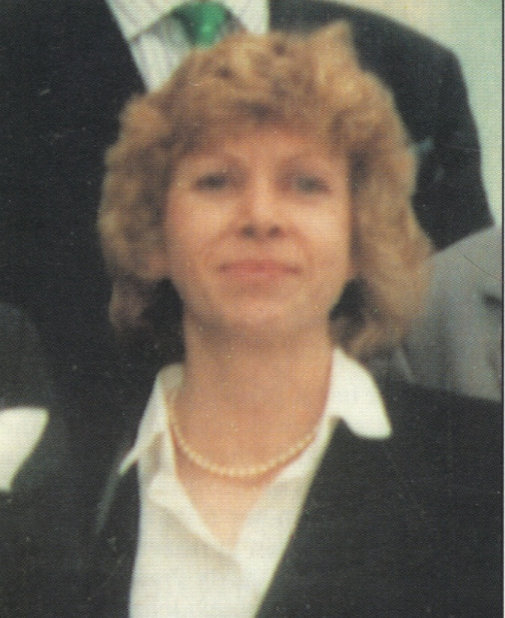
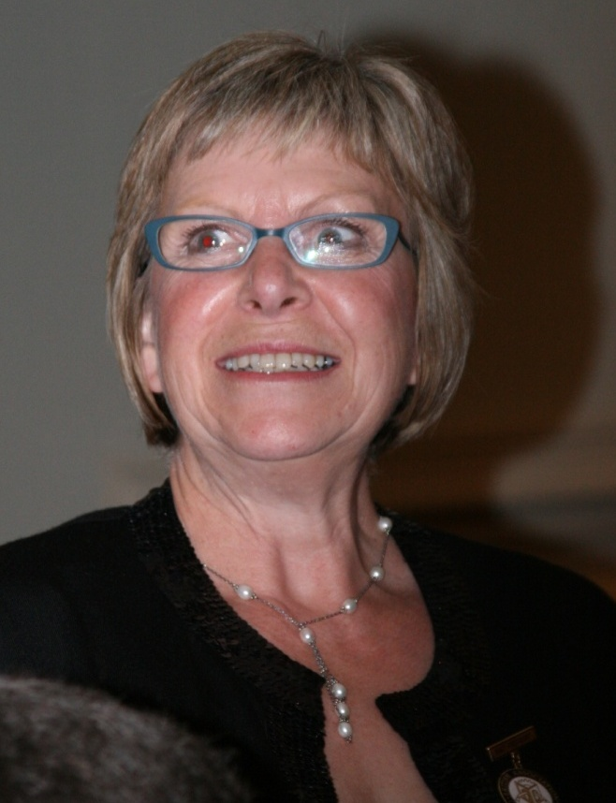
1996 -1998 Sarah Penn

Slide 33
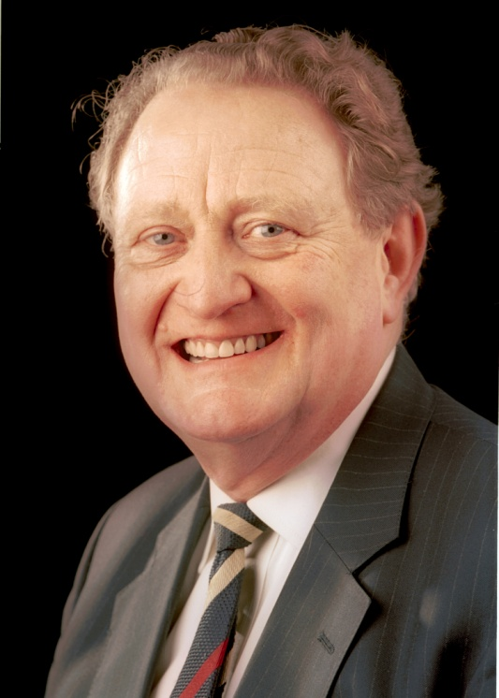
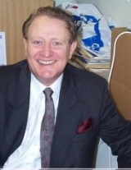
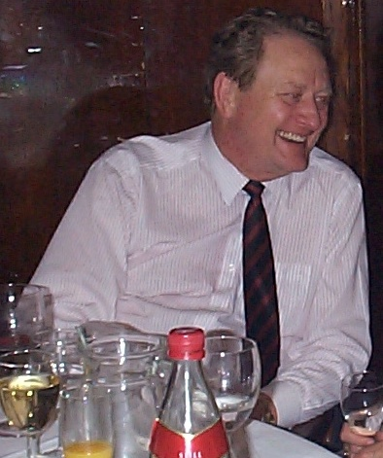
1998 -2000 Peter Simpson

Slide 34
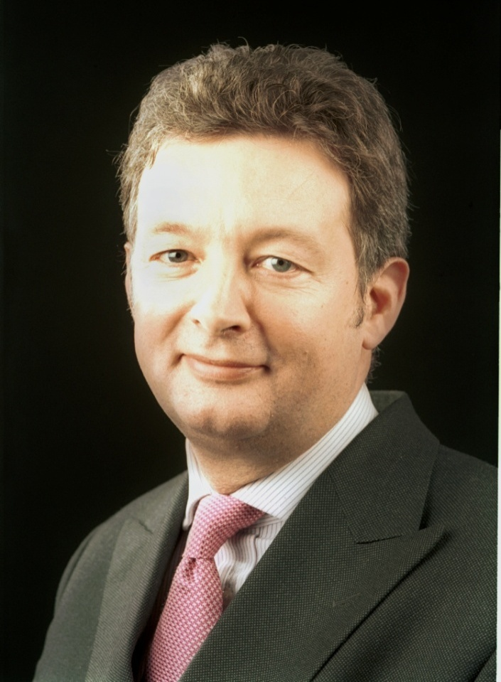
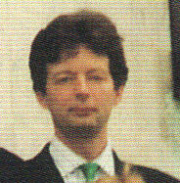
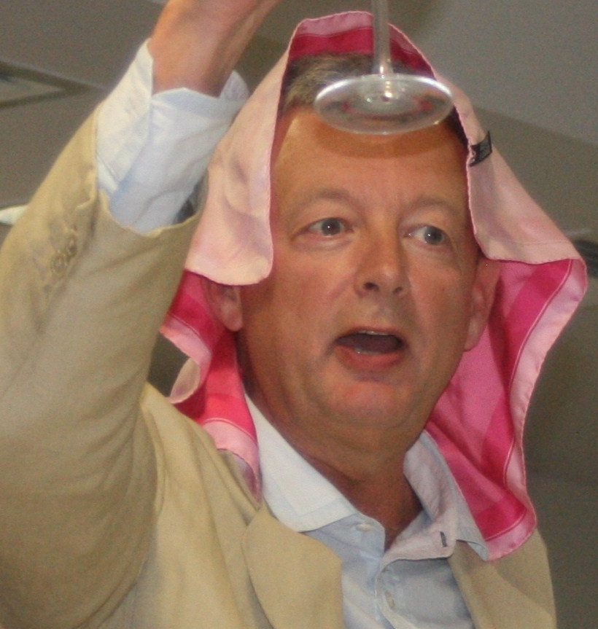
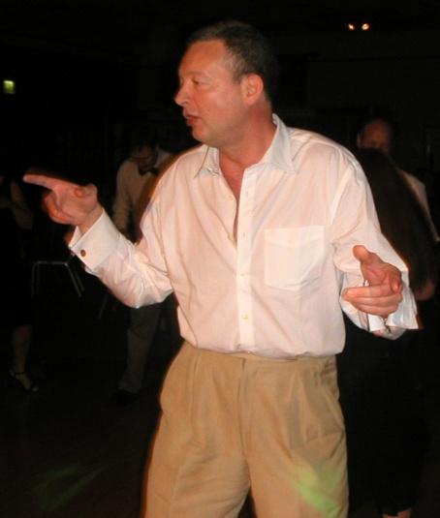
2000 -2002 Paul Baskerville

Slide 35
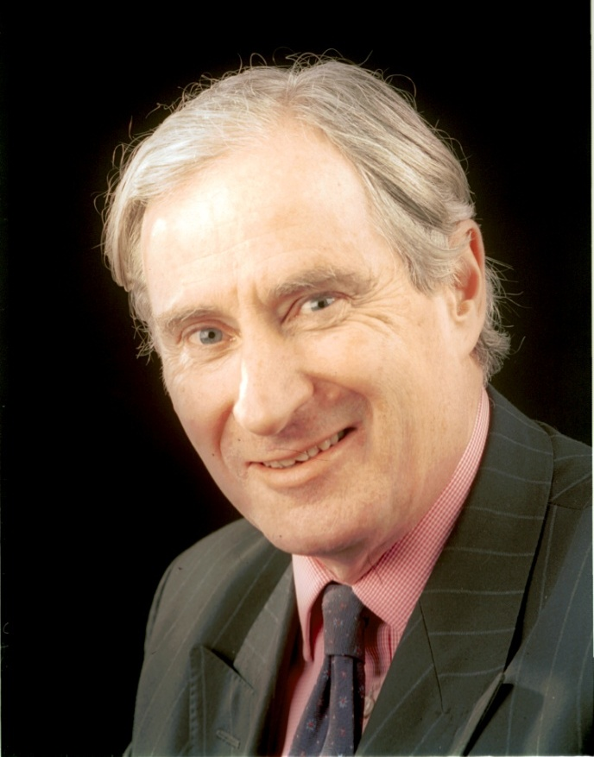
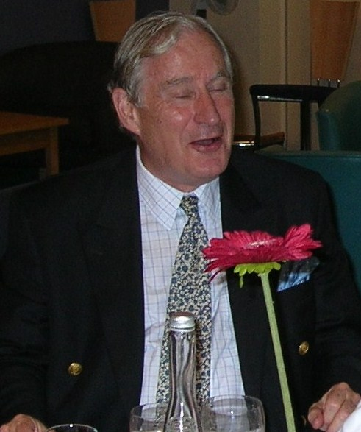
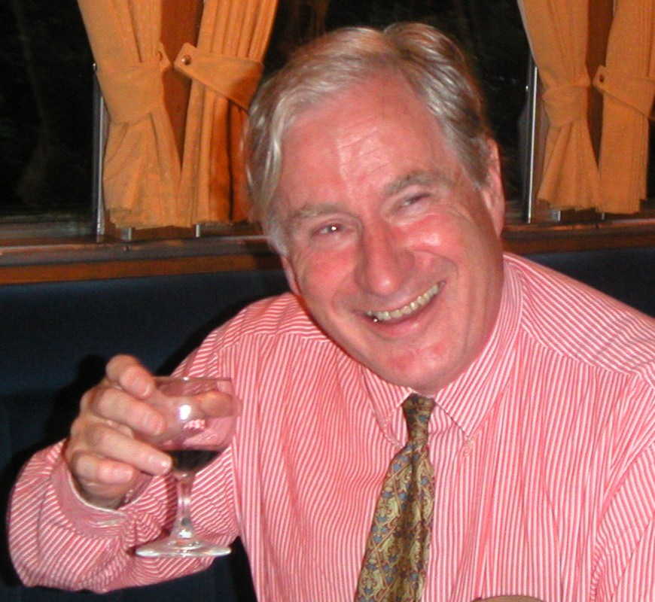
2002 -2004 David Ralphs

Slide 36
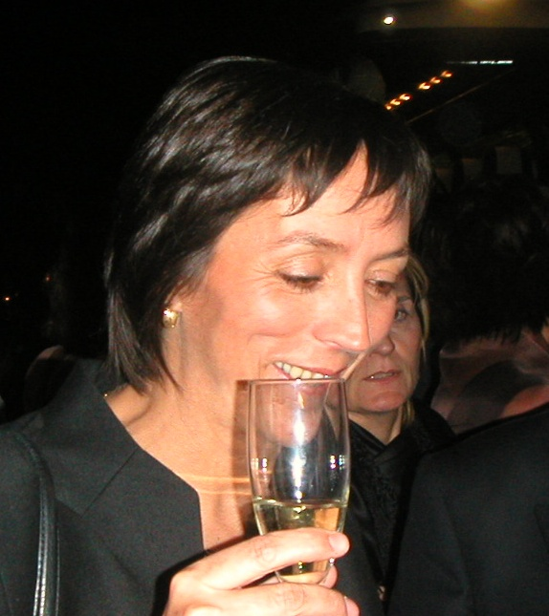
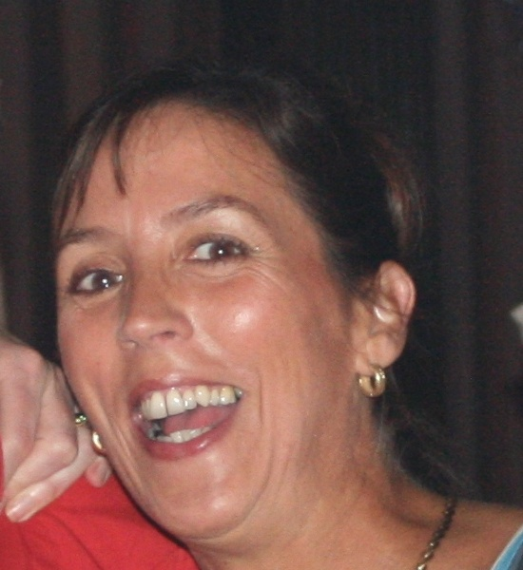
2004 -2006 Jill Solly

Slide 37
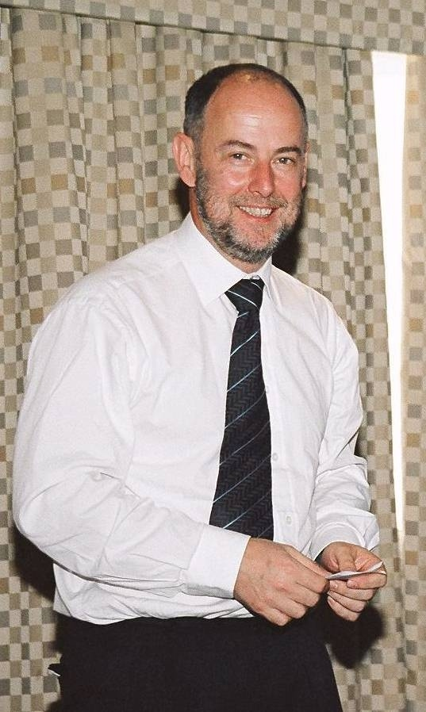
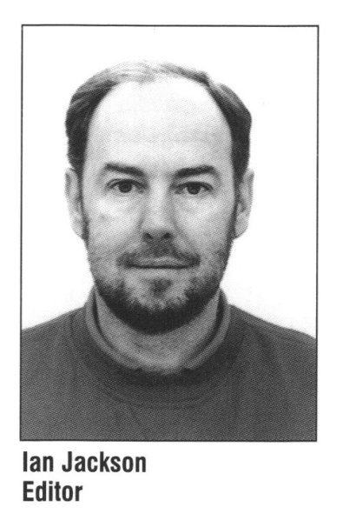
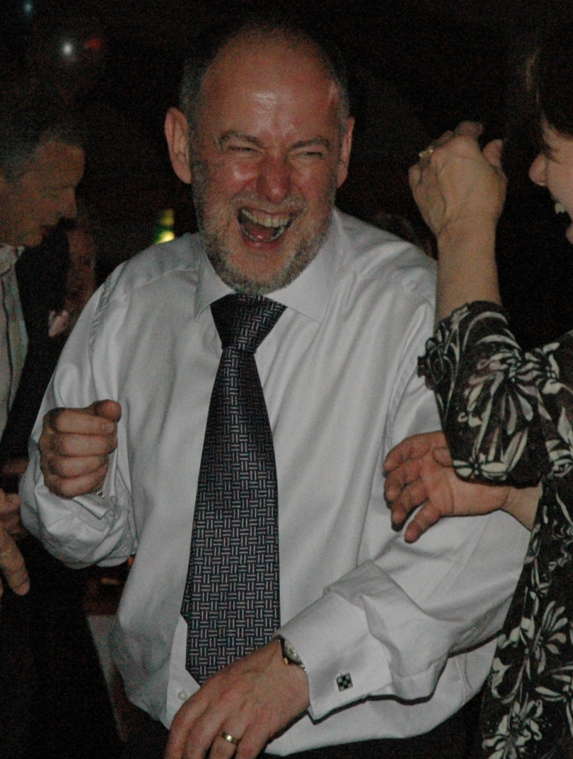
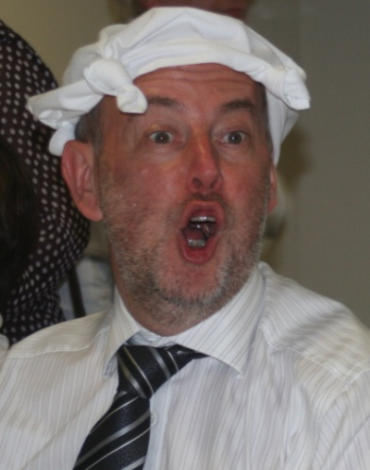
2006 -2008 Ian Jackson

Slide 38
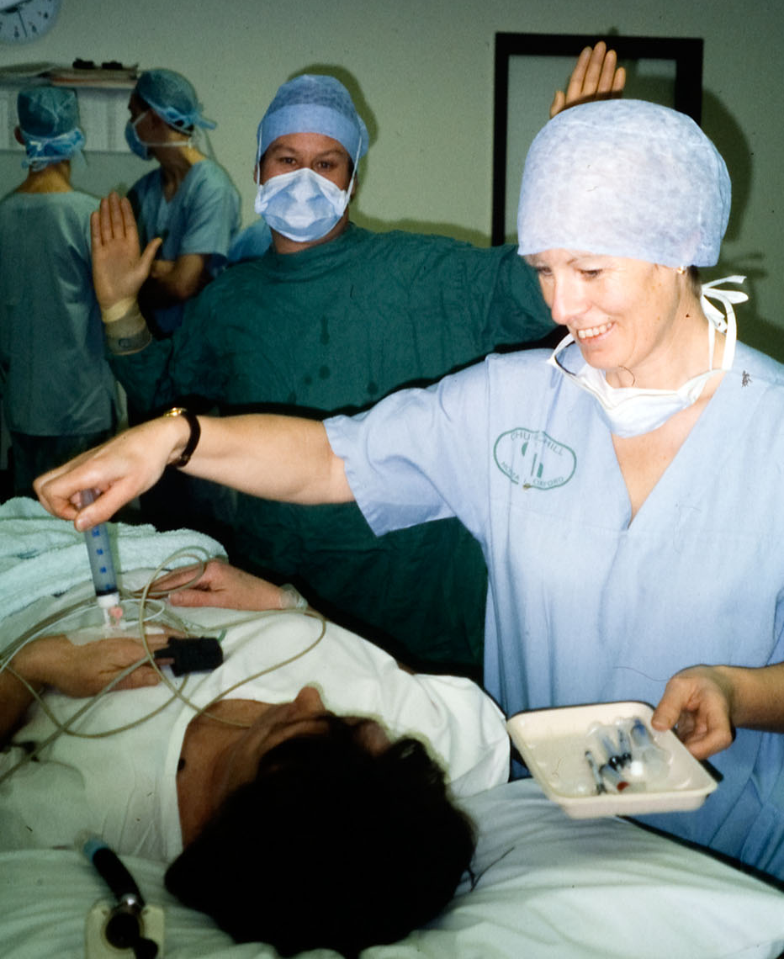
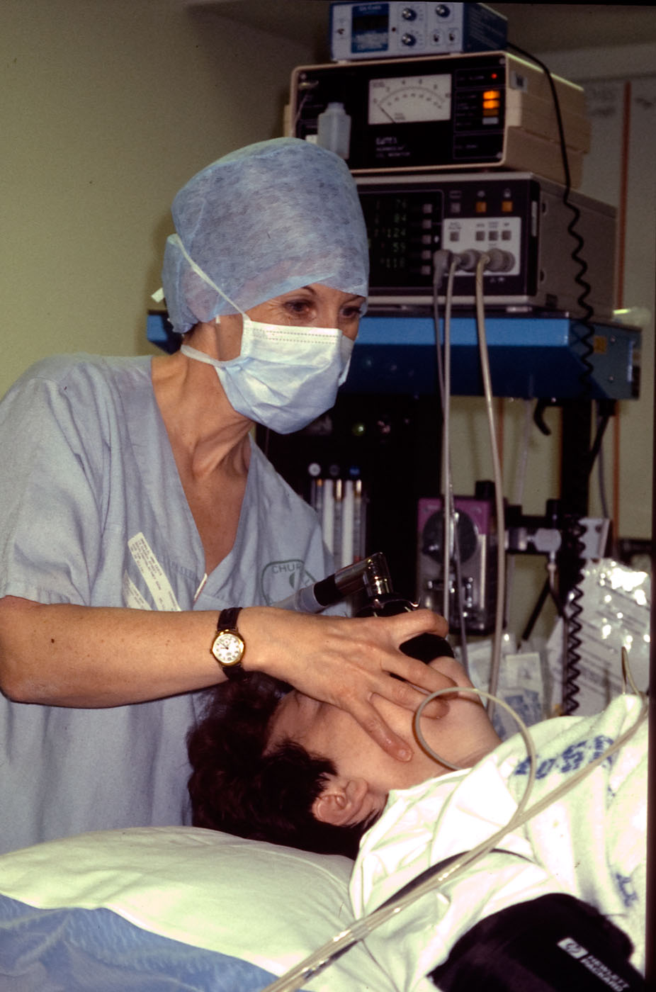
Jean Millar

Slide 39
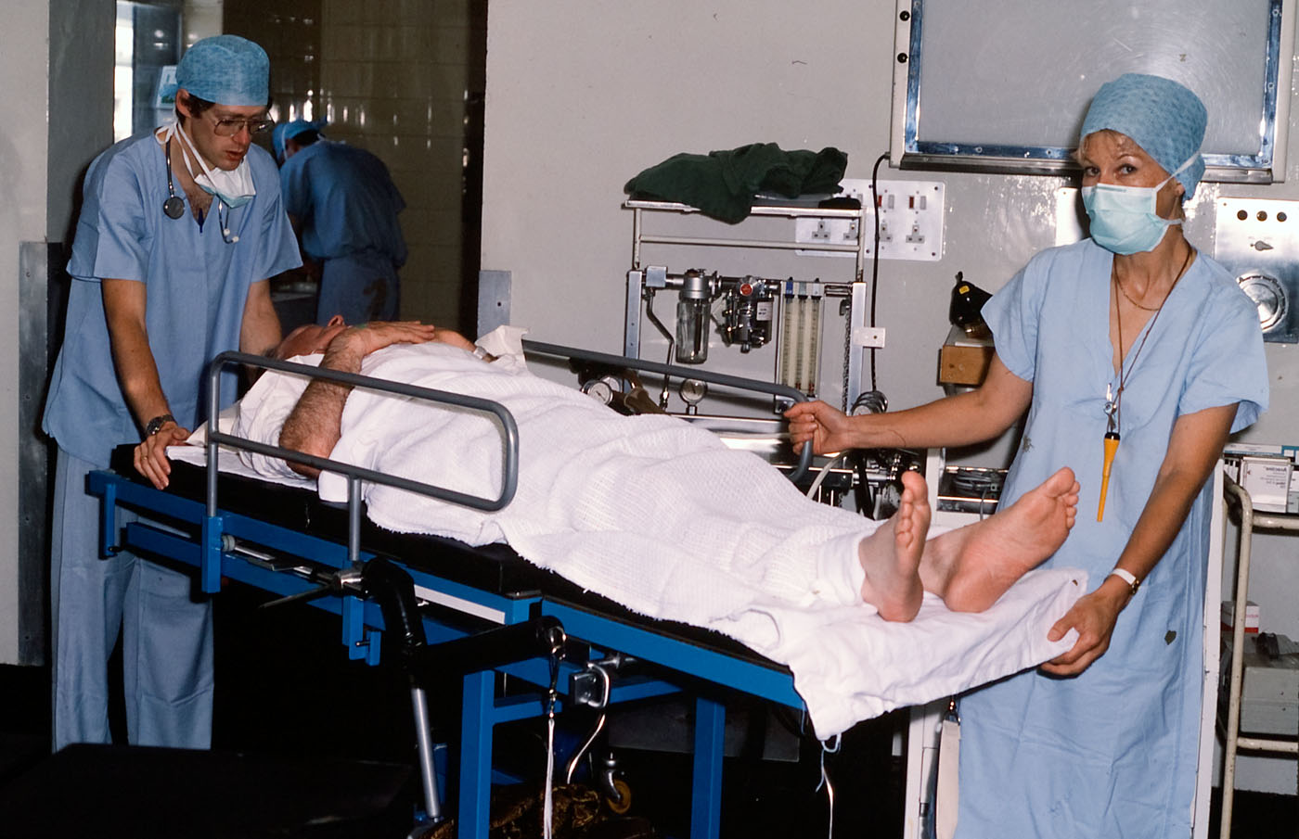
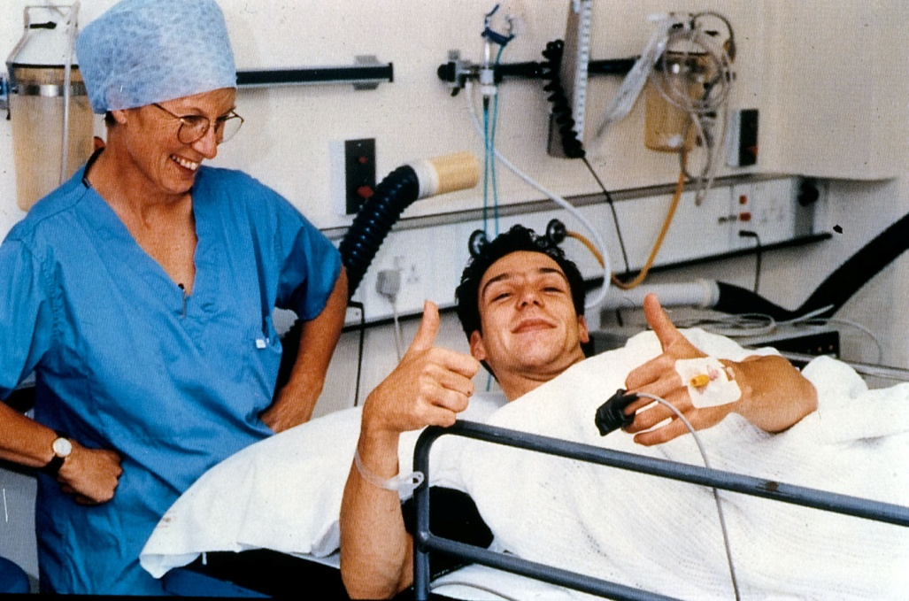
Jean Millar

Slide 40
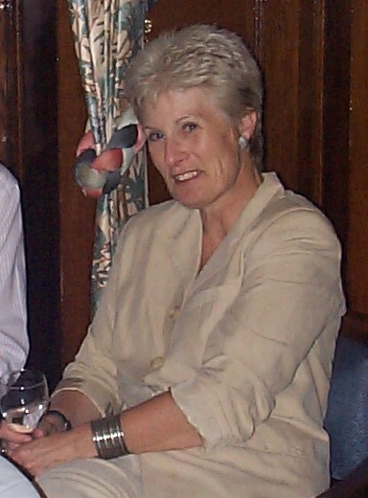
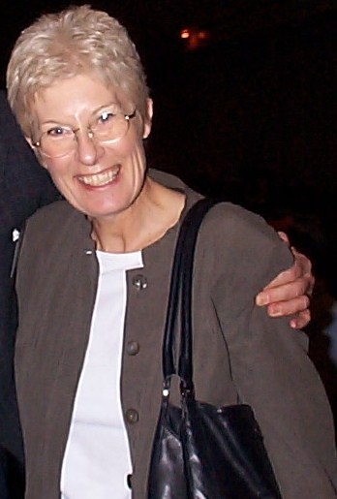
Jean Millar

