Slide 1
AMBULATORY BREAST SURGERY: MAKING A DREAM A REALITY
MR ANIL J DESAI
ONCOPLASTIC BREAST SURGEON AND BREAST CANCER LEAD
SOUTH LONDON HEALTHCARE TRUST

Slide 2
WHY?
PATIENT FACTORS
    Guaranteed date, no cancellations
    Minimise SSI
    Better patient acceptance
    Psychological advantage
    Safe

Slide 3
WHY?
CLINICIAN FACTORS
    No cancellations
    Minimise SSI
    Greater throughput
    REDUCED LOS
    FREES UP INPATIENT BEDS
    Reduces length of safari ward round
    SAVINGS

Slide 4
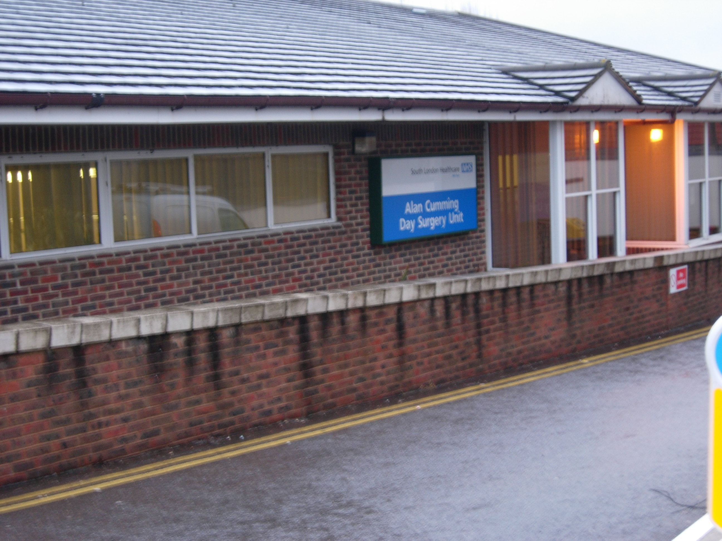
WHERE?
DAY SURGERY UNIT
    Dedicated unit best
        Trained motivated staff
        No portering required
        Quick turnover
        Logistics
        NO THREAT TO BEDS FROM EMERGENCIES

Slide 5
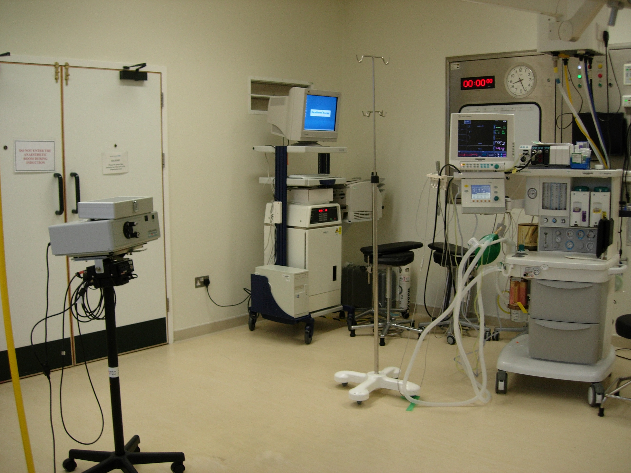

Slide 6
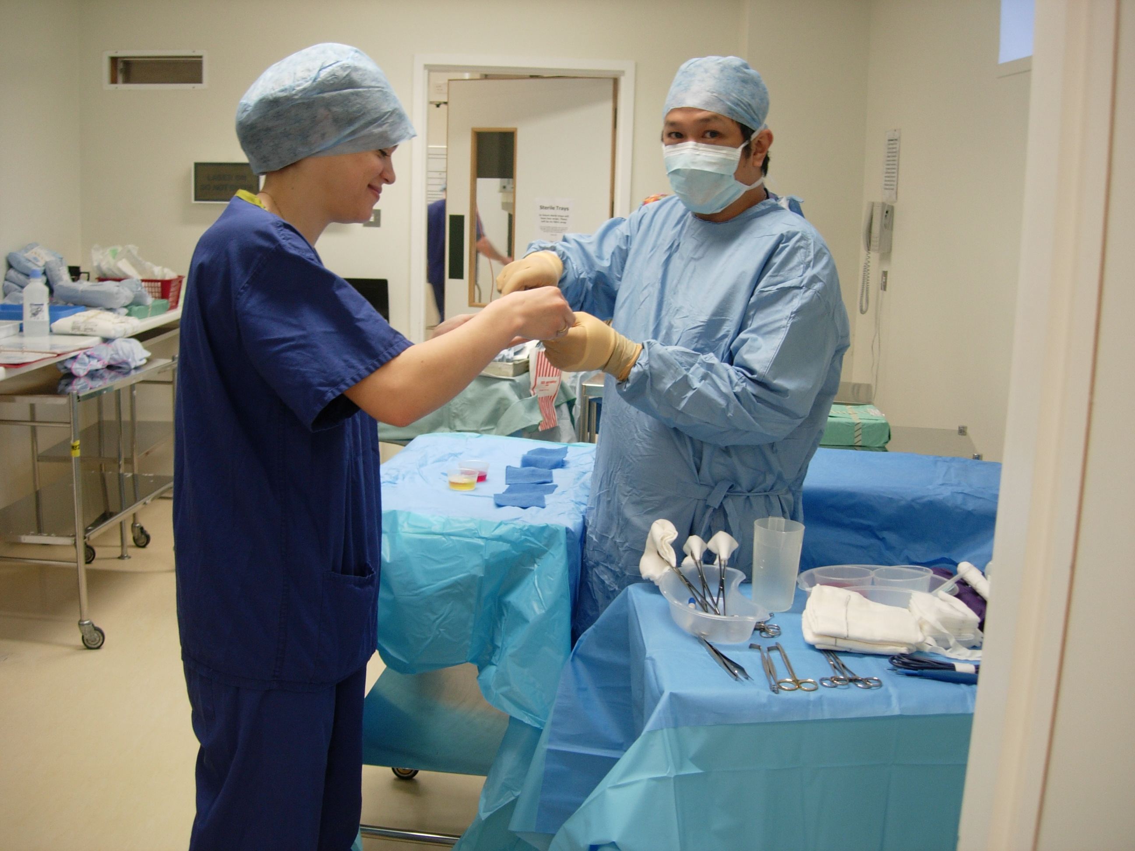

Slide 7
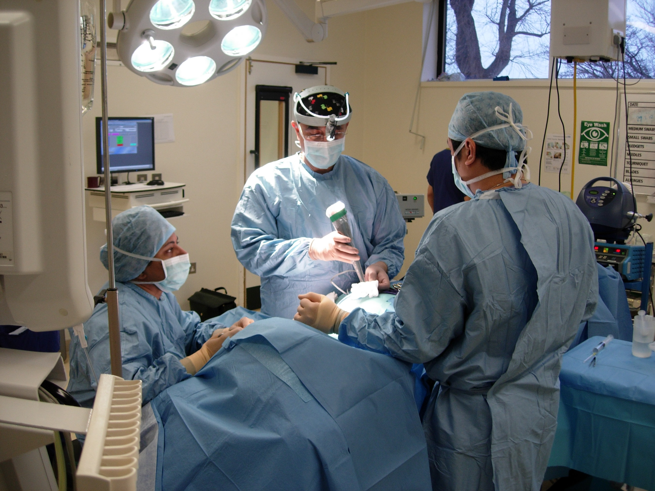

Slide 8
HOW?
All day list –range of cases
Facilities
Training
Patient education
Continued care at home
Access to urgent outpatient appointments

Slide 9
BREAST SURGERY - CONVENTIONAL
EXCISION BIOPSY
WIDE LOCAL EXCISION AND SNB/AXILLARY CLEARANCE
SIMPLE MASTECTOMY
MASTECTOMY AND SNB/AXILLARY CLEARANCE
MICRODOCHECTOMY/HADFIELD PROCEDURE

Slide 10
BREAST SURGERY-ONCOPLASTIC
BREAST CONSERVATION
  PARTIAL BREAST RECONSTRUCTION
    GLANDULAR MOBILISATION AND ADVANCEMENT/ROTATION
    THERAPEUTIC MAMMAPLASTY
SYMMETRISATION
  BREAST REDUCTION
  BREAST AUGMENTATION
  MASTOPEXY

Slide 11
BREAST SURGERY-ONCOPLASTIC
BREAST RECONSTRUCTION
  IMPLANT
  EXTENDED LD FLAP
  LD FLAP AND IMPLANT
  PEDICLED TRAM, FREE TRAM, DIEP, SGAP
REVISION OF BREAST RECONTRUCTION
  CAPSULOTOMY/IMPLANT EXCHANGE
  SCAR REVISION
  POCKET REVISION
  GLANDULAR RESHAPING
NIPPLE RECONSTRUCTION

Slide 12
DAY SURGERY UNIT CASEMIX (242 PROCEDURES)
OCTOBER 2008-DEC 2009
Breast conserving surgery | 98 (WLE 32,WLE+SNB 60,WLE+AX.CL6)
Mastectomy | 9 (mx 2, mx +ax cl 1, Mx + snb 6)
Axillary surgery alone | 14 (ax.cl 8, snb 6)
Revision of breast reconstruction | 10
Symmetrisation surgery | 24(mastopexy 2, reduction 2, augmentation 6, lipofilling 14)
Surgery on nipples | 59 (nipple reconstruction 51, total duct excision 3, microdochectomy 4, nipple eversion 1)
Excision biopsy | 22
Other | 10

Slide 13
PRUH/OTC CASEMIX (118 procedures)
OCT 2008- DEC 2009
Breast conserving surgery | 31(WLE 8, WLE+SNB 18,WLE+AX.CL 5)
Mastectomy | 25 (mx 7, mx + ax. cl 7, mx+ snb 11)
Axillary surgery alone | 12 (ax.cl 10, snb 2)
Breast reconstructions | 29 (mx+LD 3, mx +LD + implant 10, mx+implant 11, mx+implant +reduction 4, mx+implant+mastopexy 1)
Revision breast reconstructions | 4
Symmetrisation surgery | 10 (reduction 5, mastopexy 3, augmentation 1, lipofilling 1)
Operations on nipple | 4 (nipple reconstruction 2, duct excision 2)
Excision biopsy | 3

Slide 14
READMISSION RATE
OCT 2008-DEC 2009
3 cases
  Haematoma requiring evacuation
  Allergic reaction to Patent Blue V
  Delayed finish to list (mastopexy)

Slide 15
SUMMARY
Majority of breast surgery can be carried out as day surgery
It is safe
Patients prefer it
Makes it easy to manage the service
SCOPE
Cross site learning – breaking down barriers
Training of teams
Reducing need for second operations (Sentinel lymph node analyser)
Considering breast reconstructions in 23 hour day surgery setting

