Slide 1
An Audit of
Preoperative Investigations for Day Surgical Cases

Slide 2
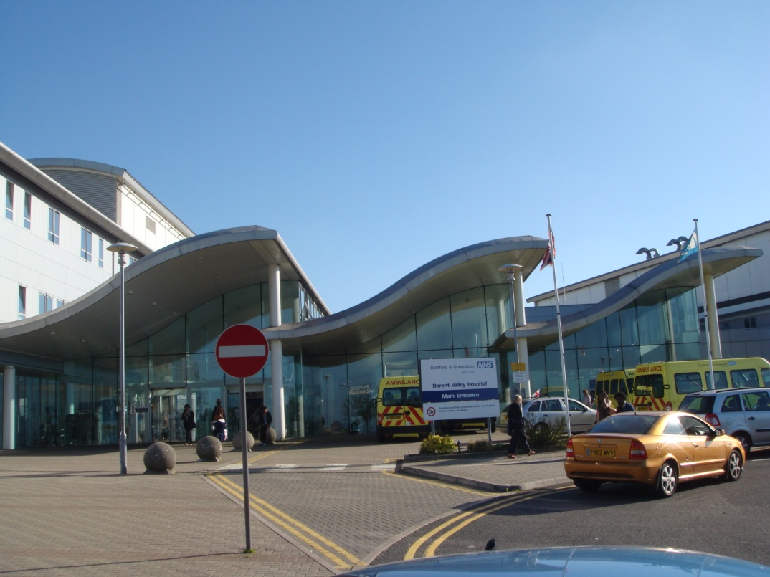
Dr.A.Relwani Dr.R.Sucharita Dr.S.Sivakumaran Darent Valley Hospital
Dartford

Slide 3
Introduction
Routine preoperative investigations have both health and resource implications

Slide 4
Possible Benefits:
  Early diagnosis of serious conditions
  Baseline measurement for reference
  Reduction in number of perioperative complications

Slide 5
Possible Benefits:
  Early diagnosis of serious conditions
  Baseline measurement for reference
  Reduction in number of perioperative complications
Potential disadvantages:
  Iatrogenic effects of initial and additional tests
  Anxiety associated with positive results
  Delays or cancellations in surgery
  Cost implications

Slide 6
  Uncertainty regarding their clinical and cost effectiveness
  Marked variation in medical staff requesting preoperative tests
  Some evidence that management is not altered even with true abnormal results in healthy patients

Slide 7
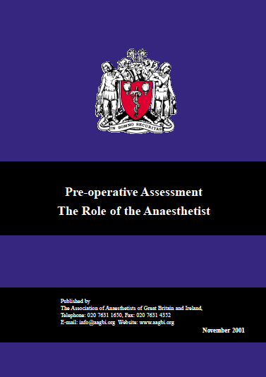

Slide 8
NHS Modernisation Agency
National Good Practice Guidance on
Pre-operative Assessment for Day
Surgery (2002)

Slide 9
Blanket routine preoperative tests
Minor surgery in healthy patients – none required
Necessary investigations
Clear demarcation between health screening vs. necessary tests
ineffective
expensive
unnecessary

Slide 10
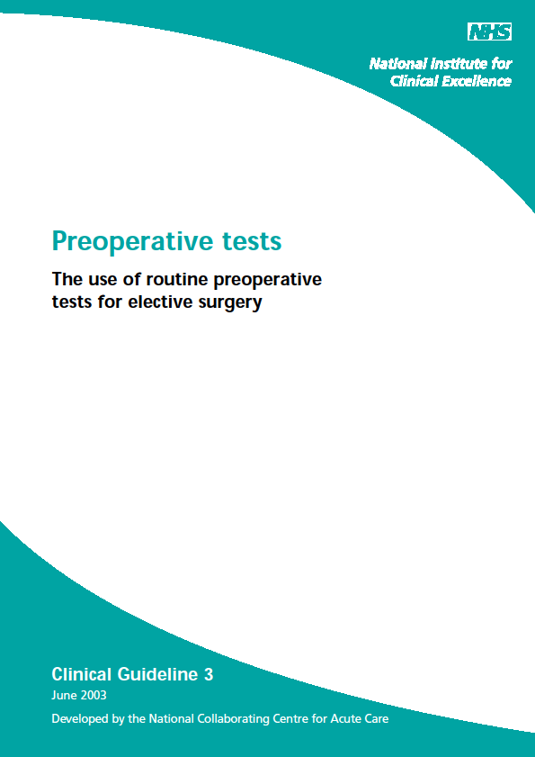

Slide 11
Nice Guidelines 2003
Preoperative tests
11 tests were investigated
          with respect to age
          grade of surgery
          comorbidity
          severity of comorbidity
Recommendations

Slide 12
Aims and Objectives
Audit the investigations performed at pre-assessment for day surgical cases.
Compare them with NICE recommendations.
Formulate updated guidelines for our trust.
Reaudit the implementation and adherence to the new guidelines.

Slide 13
Methods- First Audit :
Retrospective – August 2008
45 patients (adults and children)
Day Care surgical procedures
Information collected from preoperative assessment booklet
Findings compared with NICE recommendations

Slide 14
Results
Total number of cases studied - 45
ASA grades 1 - (76%)
2 - (22%)
3 - ( 2%)
Grades of Surgery 1 - (69%)
2 - (31%)

Slide 15
Results contd.
Total number of tests performed - 110
Investigations indicated: 3 ( 3%)
Not indicated: 66 (63%)
No Consensus: 35 (34%)
Abnormal results: 5
Change in management: none
Adverse outcomes: none
All tests recommended by NICE performed

Slide 16
Modified Trust Guidelines
  NICE indicated tests - included
  Not indicated tests - excluded
  No consensus group - local guidelines drawn after consultations within anaesthetic department
FBC, Glucose, LFT, ECG - main tests modified
Period of validity of tests - extended from 12 weeks to 18 weeks

Slide 17
Preoperative Investigations for Elective Surgery
 | Minor | Intermediate | Major | Major +
ASA 1 | FBC > 60yrs U&E > 60yrs ECG > 60yrs | Same as for minor | FBC All U&E All ECG >60yrs | FBC All U&E All Clotting All ECG >60yrs

Slide 18
Preoperative Investigations for Elective Surgery
 | Minor | Intermediate | Major | Major +
ASA 1 | FBC > 60yrs U&E > 60yrs ECG > 60yrs | Same as for minor | FBC All U&E All ECG >60yrs | FBC All U&E All Clotting All ECG >60yrs
ASA 2 | FBC Cardiac/Renal U&E Renal ECG All Cardiac Resp/Renal>50 yrs | Same as for minor | FBC All U&E All Clotting All ECG All Cardiac Resp/Renal >50 yrs | Same as for major

Slide 19
Preoperative Investigations for Elective Surgery
 | Minor | Intermediate | Major | Major +
ASA 1 | FBC > 60yrs U&E > 60yrs ECG > 60yrs | Same as for minor | FBC All U&E All ECG >60yrs | FBC All U&E All Clotting All ECG >60yrs
ASA 2 | FBC Cardiac/Renal U&E Renal ECG All Cardiac Resp/Renal>50 yrs | Same as for minor | FBC All U&E All Clotting All ECG All Cardiac Resp/Renal >50 yrs | Same as for major
ASA 3 | FBC All U&E All Clotting Renal ECG All | Same as for minor | FBC All U&E All Clotting All ECG All | Same as for major

Slide 20
Preoperative investigations for elective surgical patients
FBC
Known or suspected anaemia, thalassemia, Hemoglobinopathies or
bleeding disorders
Symptomatic cardiovascular or pulmonary disease
Chronic renal disease or rheumatoid
Anticoagulant drugs
Urea and Electrolytes
Renal disease, Diabetes, Hypertension
Severe cardiovascular or respiratory disease
Drug Therapy – Diuretics, Ace Inhibitors, Digoxin, Potassium channel blockers, Long term NSAIDs , Steroids and Lithium

Slide 21
Glucose
Diabetes or family h/o Diabetes
Obesity, BMI > 35
Steroids (Oral)
Clotting
Liver disease
Bleeding diseases
Alcohol Intake >50 units per week
Anticoagulants
Severe renal disease

Slide 22
Liver Function Tests
Liver disease
Alcohol Intake > 50 units per week
Glycosylated Hemoglobin (HbA1C)
All Diabetics (unless measured in the previous 4 months)
Thyroid function tests
Diagnosed or suspected Thyroid disease (unless in the previous 6 months)
New Atrial fibrillation
Chest X Ray
Severe Cardiorespiratory Disease
Known or suspected malignancy or Tuberculosis
Previous Thoracic Surgery
New Chest signs
ECG
High risk patients > 50 yrs ( family history, hyperlipidemia, smokers)
BMI >35, respiratory or renal disease
All patients with known or suspected heart disease and diabetes

Slide 23
Sickle Cell Screening
People of African, Caribbean and Mediterranean origin should be offered screening with informed consent
Pregnancy Test
Should be carried out with a woman’s informed consent if there is any doubt that she may be pregnant
Drug Levels
Required only if change in patient’s condition or medication

Slide 24
Reaudit
Retrospective July – August 2009
96 patients of similar group
Implementation and adherence to new guidelines checked.

Slide 25
Results of Reaudit
Total number of cases studied - 96
ASA grades 1 (46%)
2 (48%)
3 ( 6%)
Grades of Surgery 1 (23%)
2 (73%)
3 ( 4%)

Slide 26
Reaudit results contd.
Total number of tests performed 223
Investigations indicated: 214(96%)
Not indicated: 9(4%)
Abnormal results: 22
Change in management: none
Adverse outcomes: none
One test recommended by NICE - not performed

Slide 27
Reaudit results contd.
Number of patients not needing any tests: 36
Total number of tests avoided after rationalisation: 115
Total number of tests avoided due to extended period of validity: 40
Total number of tests saved on: 155
    FBC 53
    U&E 18
    Glucose 56
    LFT 12
    ECG 16

Slide 28
Conclusions
Successful implementation and adherence to new guidelines.
Reduction in unnecessary testing without compromising patient safety.
Better utilisation of nursing time and resources.
Significant cost savings.

Slide 29
Future recommendations ?

Slide 30
Thank You

Slide 31
NICE : Surgery grades
Grade 1 (Minor)
Excision of skin lesion, abscess drainage, diagnostic endoscopy larynx, bronchus, oesophagus, upper GI, bladder
Grade 2 (Intermediate)
Inguinal hernia, varicose veins, adenotonsillectomy, knee arthroscopy, endoscopic operations, diagnostic laparoscopy
Grade 3 (Major)
Total abdominal hysterectomy, TURP, Thyroidectomy, Mastectomy, Lumbar discectomy
Grade 4 (Major +)
Total joint replacement, colonic resection, open nephrectomy

Slide 32
GRADE 1&2 Surgery
Preoperative tests linked to severity of systemic disease
Disease | Severity | CXR | ECG | FBC | INR | U & E |  | LUNG FUNC | GLUCOSE
CVS | MILD |  | YES | YES
CVS | SEVERE |  | YES | YES |  | YES |  |  | YES
RESP | MILD |  | >50
RESP | SEVERE | YES | YES | YES |  | YES |  | YES | YES
RENAL | MILD |  | >50 | YES |  | YES |  |  | YES
RENAL | SEVERE |  | YES | YES | YES | YES |  |  | YES

Slide 33
GRADE 3&4 Surgery
Preoperative tests linked to severity of systemic disease
Disease | Severity | CXR | ECG | FBC | INR | U & E | BLD GASES | LUNG FUNC | GLUCOSE
CVS | MILD |  | YES | YES | YES | YES |  |  | YES
CVS | SEVERE | YES | YES | YES | YES | YES |  |  | YES
RESP | MILD |  | >50 | YES | YES | YES |  |  | YES
RESP | SEVERE | YES | YES | YES | YES | YES |  | YES | YES
RENAL | MILD |  | >50 | YES | YES | YES |  |  | YES
RENAL | SEVERE |  | YES | YES | YES | YES |  |  | YES

Slide 34
 | ASA Grade 2 mild systemic disease | ASA Grade 3 Severe systemic disease
Cardiovascular Angina Exercise tolerance Hypertension Diabetes | Occasional use of GTN Not limiting activity Well controlled on single medication Well controlled, no obvious complications | Regular use of GTN or Unstable angina limiting activity Not well controlled, on multiple medications Poorly controlled, diabetic complications
Respiratory Asthma or COPD | Well controlled | Poorly controlled
Renal | Elevated creatinine 100 – 200 μmol/L | Creatinine > 200 μmol/L Regular dialysis

