Slide 1
How to use the Procedure Directory
Ian Jackson and Mark Skues
Editors, Procedure Directory

Slide 2
A Double Act?

Slide 3
A Double Act?

Slide 5
The Audit Commission Basket of Procedures 1990
Orchidopexy
Inguinal hernia repair
Anal Fissure excision
Cystoscopy
Carpal Tunnel Decompression
Arthroscopy of Knee
Squint correction
Sub Mucous Resection
Pinnaplasty
Laparoscopy + Sterilisation
Circumcision
Excision of breast lump
Varicose veins
Dupuytren’s contracture
Ganglion excision
Cataract removal
Myringotomy
MUA # Nose
D&C
Termination of Pregnancy

Slide 6
BADS Trolley of Procedures (1999)
Laparoscopic cholecystectomy
Thorascopic sympathectomy
Partial thyroidectomy
Wide excision of breast lump
Urethrotomy
Laser prostatectomy
Eyelid surgery
Arthroscopic meniscectomy
Dentoalveolar surgery
Haemorrhoidectomy
Tonsillectomy
Submandibular gland excision
Bladder neck incision
TCRE
Hallux valgus ops
Arthroscopic shoulder ops
Tympanoplasty
Rhinoplasty

Slide 7
Audit Commission Basket of 25 Procedures (2000)
Orchidopexy
Inguinal hernia repair
Anal Fissure
Lap Cholecystectomy
TURBT
Carpal Tunnel Release
Arthroscopy of Knee
Removal of metalware
Squint correction
Tonsillectomy
MUA # Nose
D&C, Hysteroscopy
Termination of pregnancy
Circumcision
Excision of breast lump
Haemorrhoidectomy
Varicose veins
Dupuytren’s contracture
Ganglion excision
Bunion operations
Cataract removal
Myringotomy + Grommet
Sub Mucous Resection
Pinnaplasty
Diagnostic Laparoscopy

Slide 8
“Day Surgery” Department of Health, 2002

Slide 9
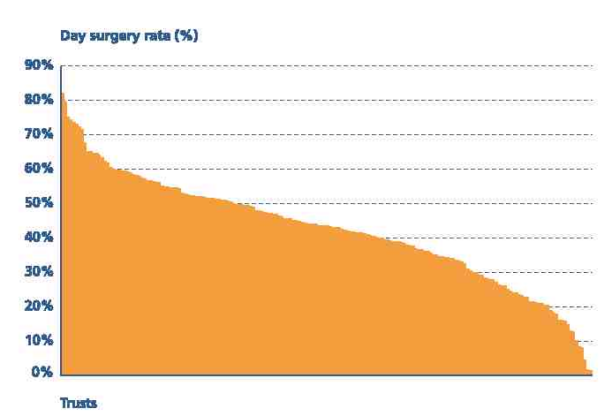
The Upper Quartile?
Inguinal Hernia Repair
52%
43%
33%
75th percentile
Median
25th percentile

Slide 10
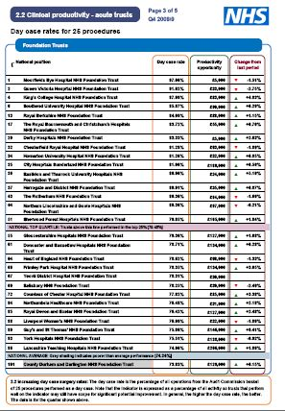
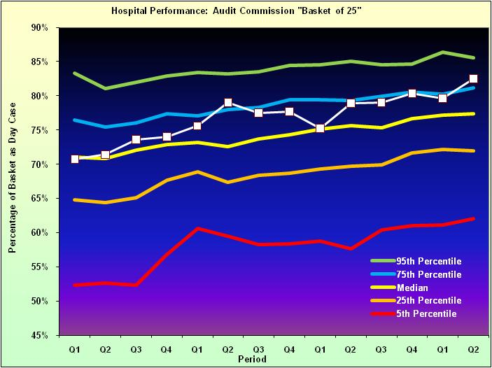
“Better Care Indices”

Slide 11
A Poor Performer?

Slide 12
Changes
Technology
Anal fissures -> GTN ointment
D&C -> outpatient hysteroscopy
Diagnostic arthroscopy -> MRI
Non essential
Cosmetic surgery
Religious circumcision
Rationing
Varicose Vein Surgery

Slide 13
The BADS Directory
Time to move away from the “Basket”..
Sub-optimal cross coding to OPCS
Not comparable across all Trusts
Advances in surgical techniques
Has given the impression that the “Basket of 25” are the only procedures to concentrate on

Slide 14
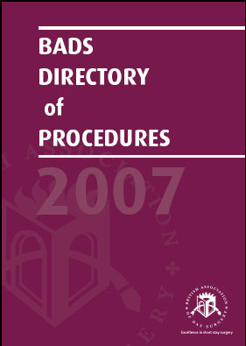
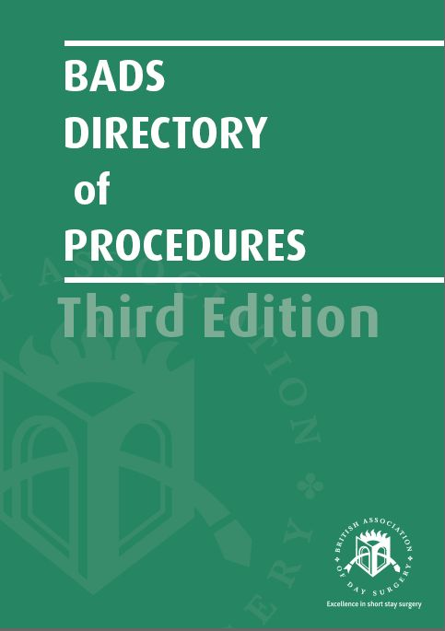
The BADS Directory

Slide 15
BADS Procedure Directory
Breast Surgery
ENT
General Surgery
Gynaecology
Head and Neck
Ophthalmology
Orthopaedic Surgery
Urology
Vascular Surgery
Paediatric Surgery
Emergency Surgery
Medical Procedures
170 Procedures

Slide 16
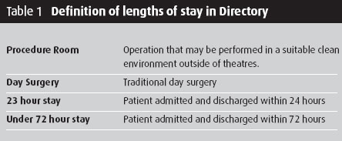
BADS Procedure Directory

Slide 17
BADS Procedure Directory
Some procedures may need longer recovery or observation times
Others may required specialised equipment or training for Clinicians to achieve their full potential
Therefore, achievement of these goals may require:
Reconfiguration of day surgery lists
Redesign of the clinical pathway
Investment in appropriate technology

Slide 18
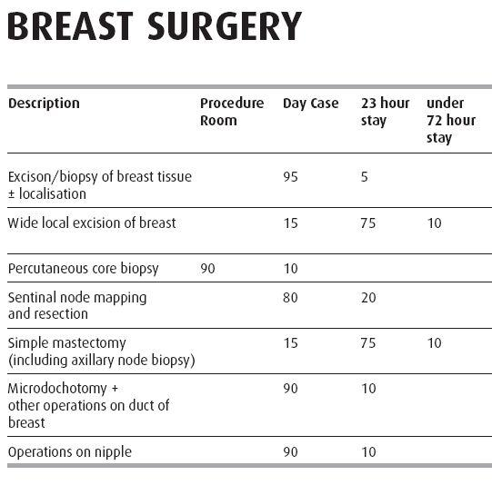
BADS Procedure Directory

Slide 19
Mastectomy, WLE + Axillary Clearance

Slide 20
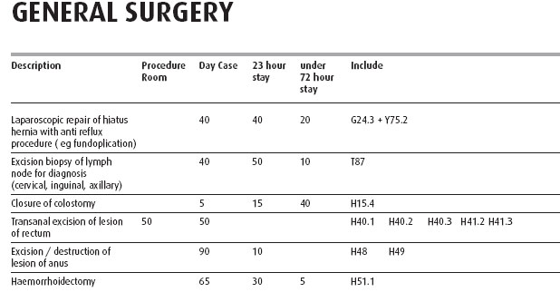
Procedure Directory

Slide 21
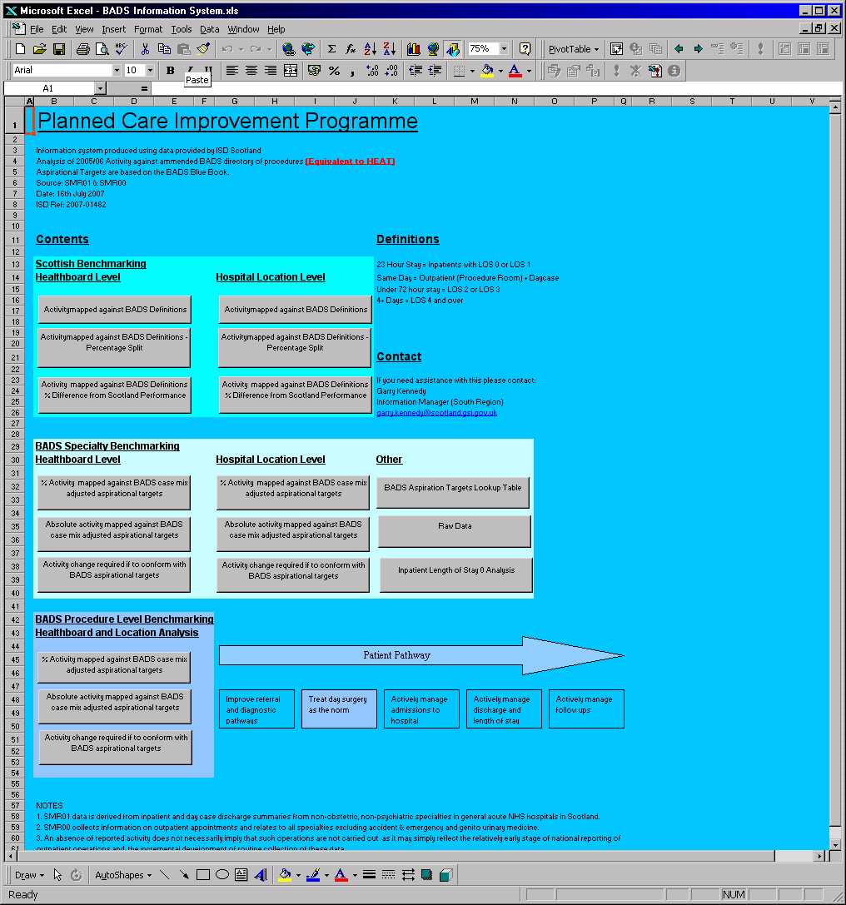
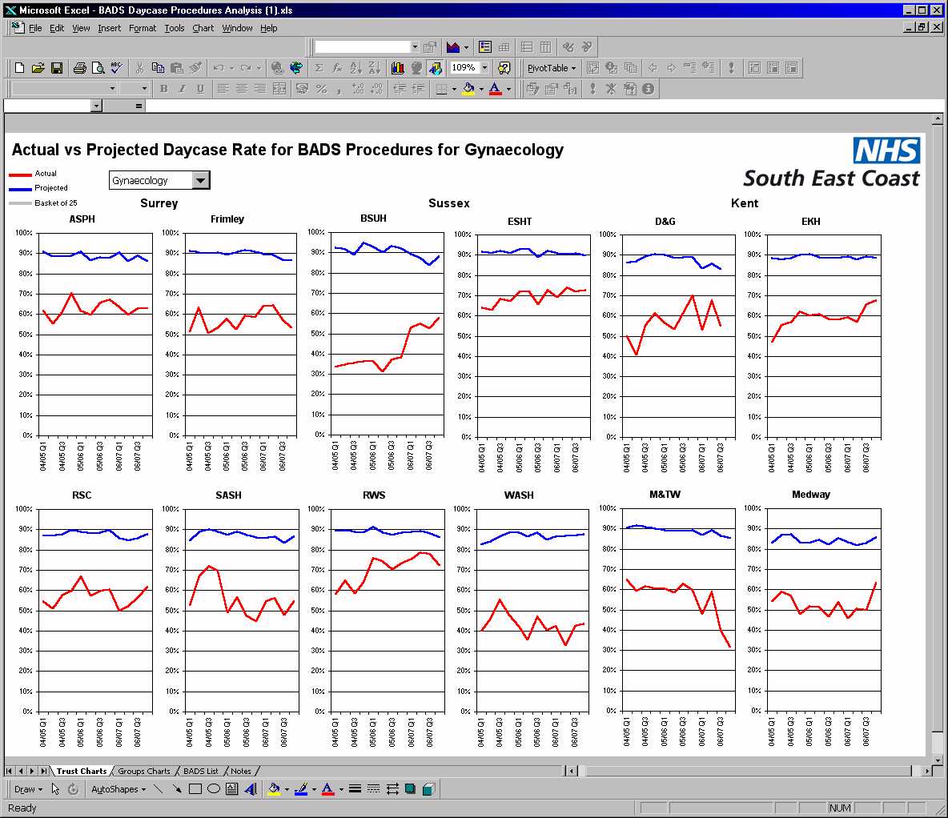
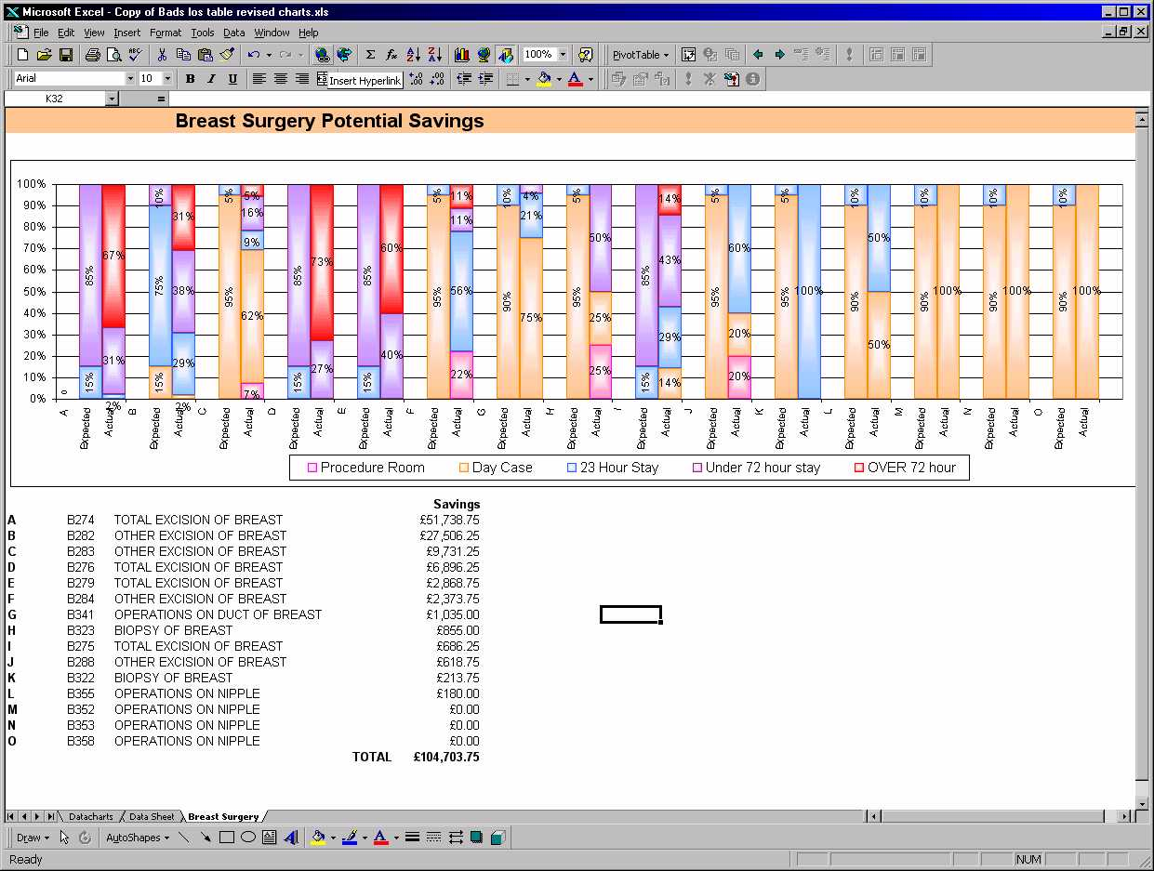
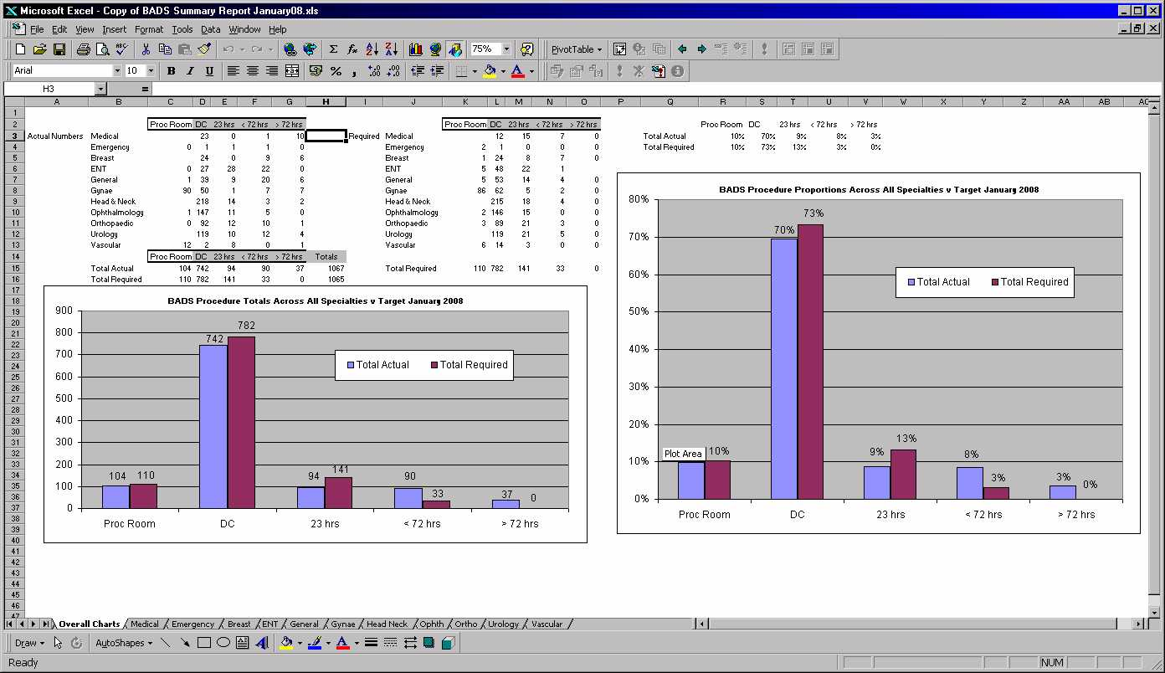
Procedure Directory...
Reviews of current activity by these benchmarks
NHS Scotland;
South East Coast SHA;
Royal Surrey;
Countess of Chester;

Slide 22
Any review method
Needs to provide understandable data for:
Every procedure
Every surgical speciality
and overall trust performance

Slide 23
A potential solution?
Use calculated length of stay
(Observed vs expected)
And, derive a summary “score” that is:
Intuitively understandable
A comparable benchmark
Reflects potential improvement across the whole timeframe of length of stay in an “encouraging” manner

Slide 26
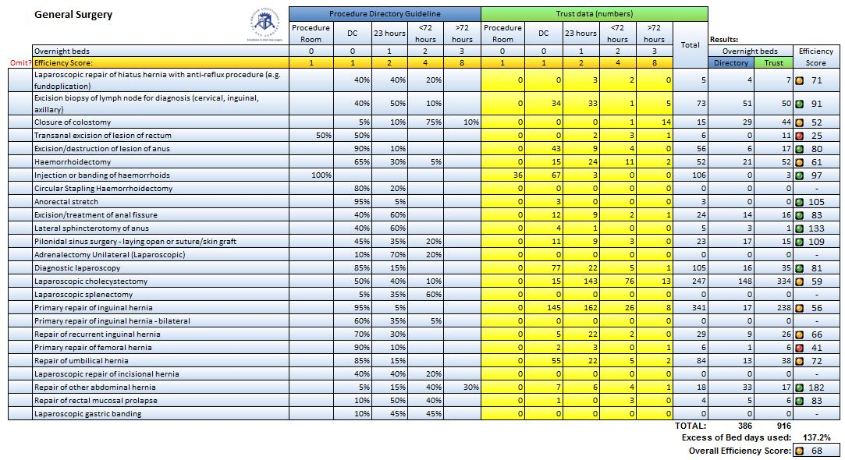
Example

Slide 27
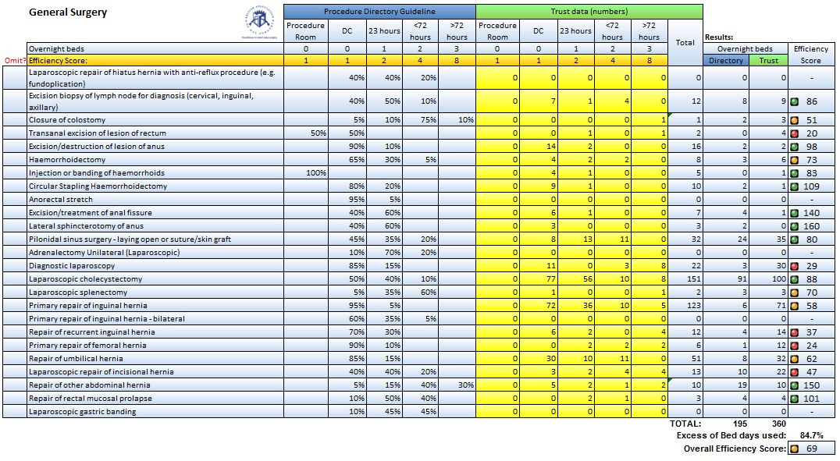
Example

Slide 28
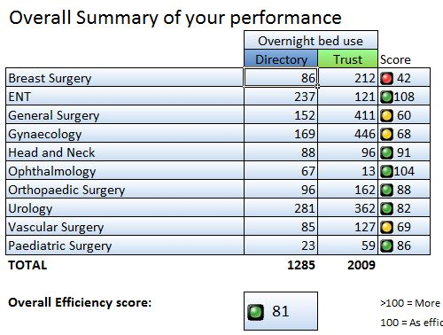
Is this good or bad?

Slide 29
Comparative benchmarking
Basket of “25” Scores:
82%
89%
73%

Slide 30
“Targets” vs “Benchmarks”
Up to individual users
NHS Scotland: 80% target by PD3
Audit Commission: Identify the “wins”

Slide 32
How to use the Procedure Directory
Mark Skues
Editor, Procedure Directory

