Slide 1
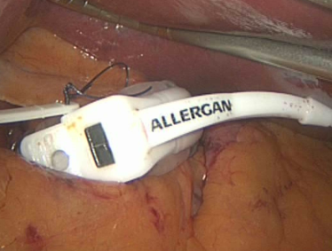
Day Case Bariatric Surgery – Time to Revise the Guidelines from the Royal College of Surgeons of England
W Hawkins, S Khan, M Seenath, P Super
Heartlands Hospital, Birmingham

Slide 2
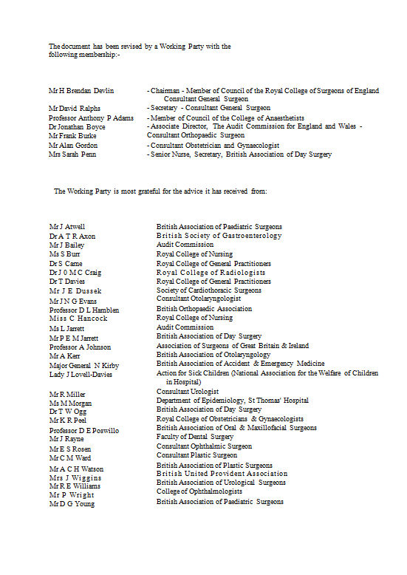
RCS Eng guidelines
1992 guidelines
Remain the current guidelines
Held in high regard by the public
Mr P E M Jarrett British Association of Day Surgery
Dr T W Ogg British Association of Day Surgery

Slide 3
The home must be within a reasonable distance of the hospital, preferably no more than one
hour’s journey by car.
Patients who are grossly
obese should be excluded (i.e. body mass index, unclothed weight (Kg) divided by height (m2), greater than
30)

Slide 4
Day case bariatric surgery
Outpatient Laparoscopic Gastric Banding: Initial Experience
Obesity Surgery, 14, 1108-1110. 2004
Boudewin De Waele et al, Bruges, Belgium
First publication
10 patients, Mean BMI 38.4, Mean stay 9.6 hours
Is Laparoscopic Adjustable Gastric Banding a Day Surgery Procedure?
Obesity Surgery, 14, 1237-1240. 2004
Karin Kormanova et al, Prague, Czech Republic
20 patients
Mean BMI 42.3
Mean stay 21 hours (overnight)

Slide 5
Day case bariatric surgery
Dr Chris Coburn (Canada)
Day case banding
Over 98% patients being performed as day cases
N = 870.

Slide 6
Day case bariatric surgery
What is your normal length of stay for patients having had LAP-BAND surgery?
Audience touch pad session

Slide 7
Day case bariatric surgery
Having seen these presentations, does the audience consider that same day discharge after LAP-BAND surgery is safe?
Audience touch pad session

Slide 8
Day case surgery
We believe that day case surgery
Is safe
Encourages earlier mobility and thereby less morbidity
Has cost benefits
Is preferred by patients
Promotes good surgical and anaesthetic practice

Slide 9
Our day case experience
Laparoscopic cholecystectomy (N > 1000)
> 80% same day discharge
Laparoscopic fundoplication (N > 600)
> 76% same day discharge
Laparoscopic Heller’s cardiomyotomy
> 60% same day discharge

Slide 10
Day case gastric band surgery
From 2007 we have offered day case to surgery for patients having laparoscopic gastric banding
Initial protocol:
BMI ≤ 60 Kg/m²
Body weight ≤ 160 kg
ASA I – II
Fully independent patient with carer at home
Exclude
Insulin dependent diabetic
Obstructive sleep apnoea
Current protocol:
Any BMI
Any body weight
Weight over 160kg admitted to main ward but still treated as a day case
ASA I – III at anaesthetists discretion
Fully independent patient with carer at home
Exclude
Insulin dependent diabetic
(Obstructive sleep apnoea)

Slide 11
Day case protocol
Counselled about day case surgery and post-op care at initial clinic visit
Day case fitness assessed preoperatively
Admitted morning of the procedure
Walk to theatre
Standardised anaesthetic, anti-emetic and analgesic regimes
LMWH 2 hours post-op
Patients discharged within 10 hours of admission if they satisfied discharge criteria
Walk out of hospital
Contacted by telephone the following morning
Followed up in clinic after 6 weeks
Dietician led follow up thereafter

Slide 12
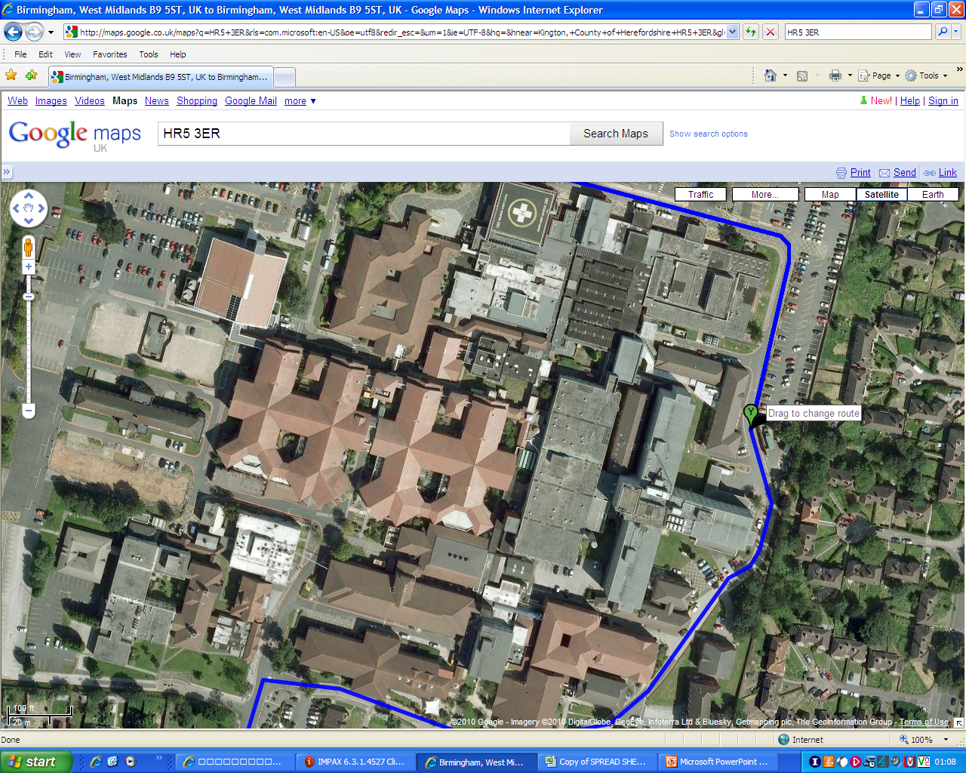

Slide 13
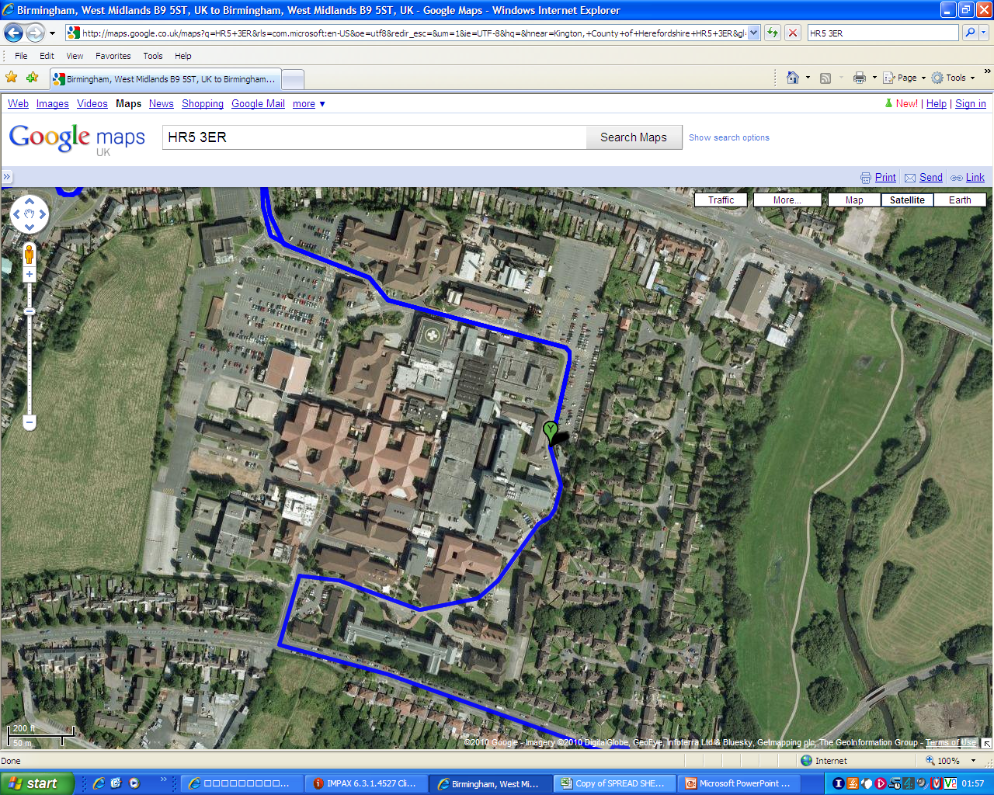

Slide 14
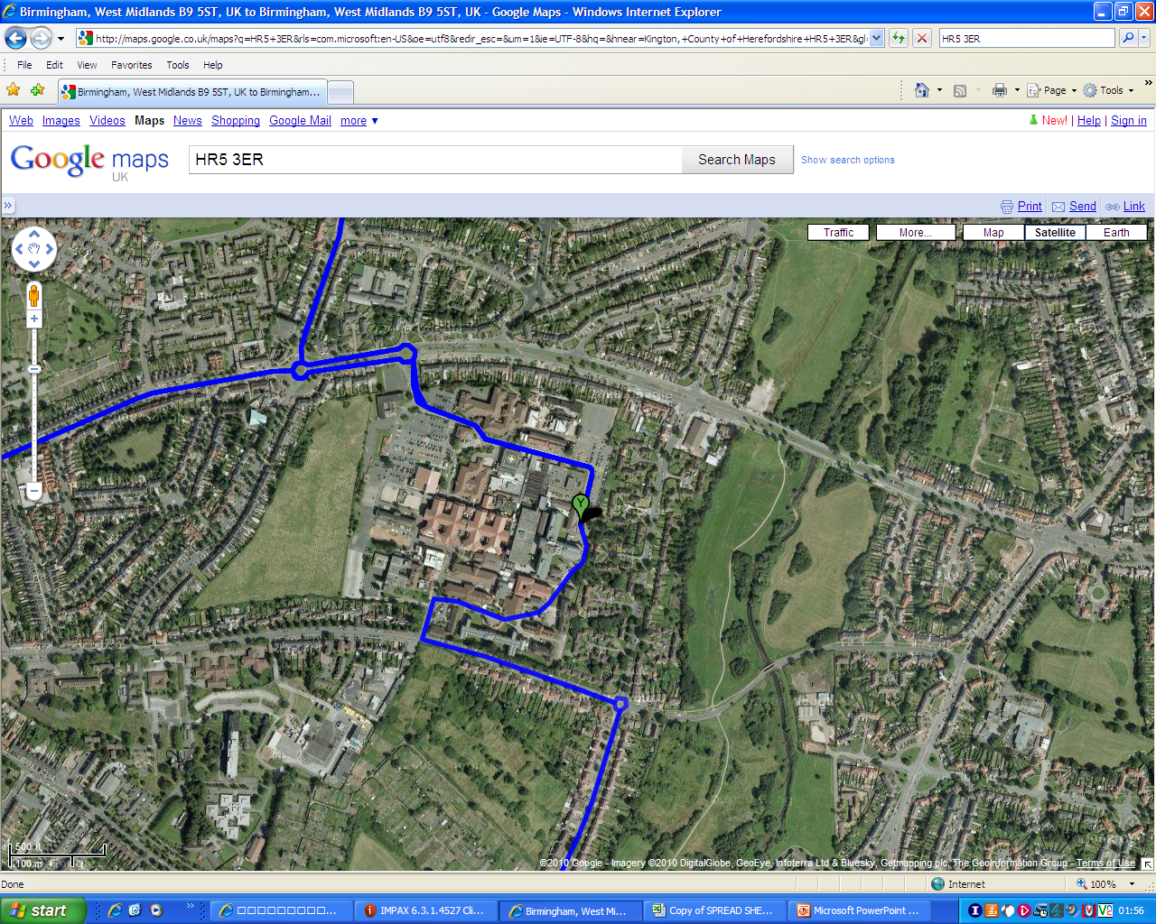

Slide 15
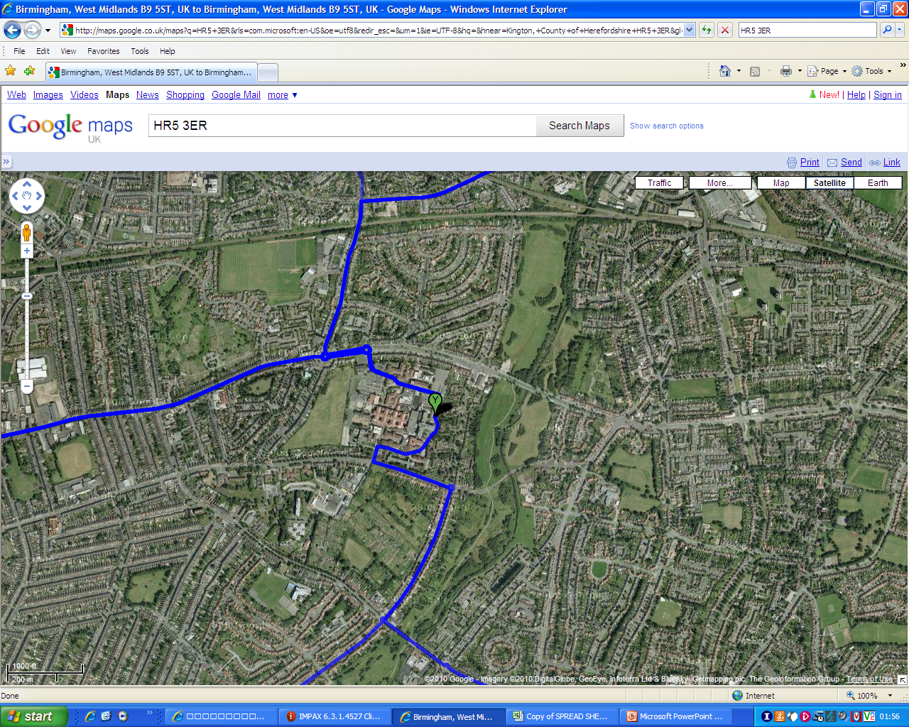

Slide 16
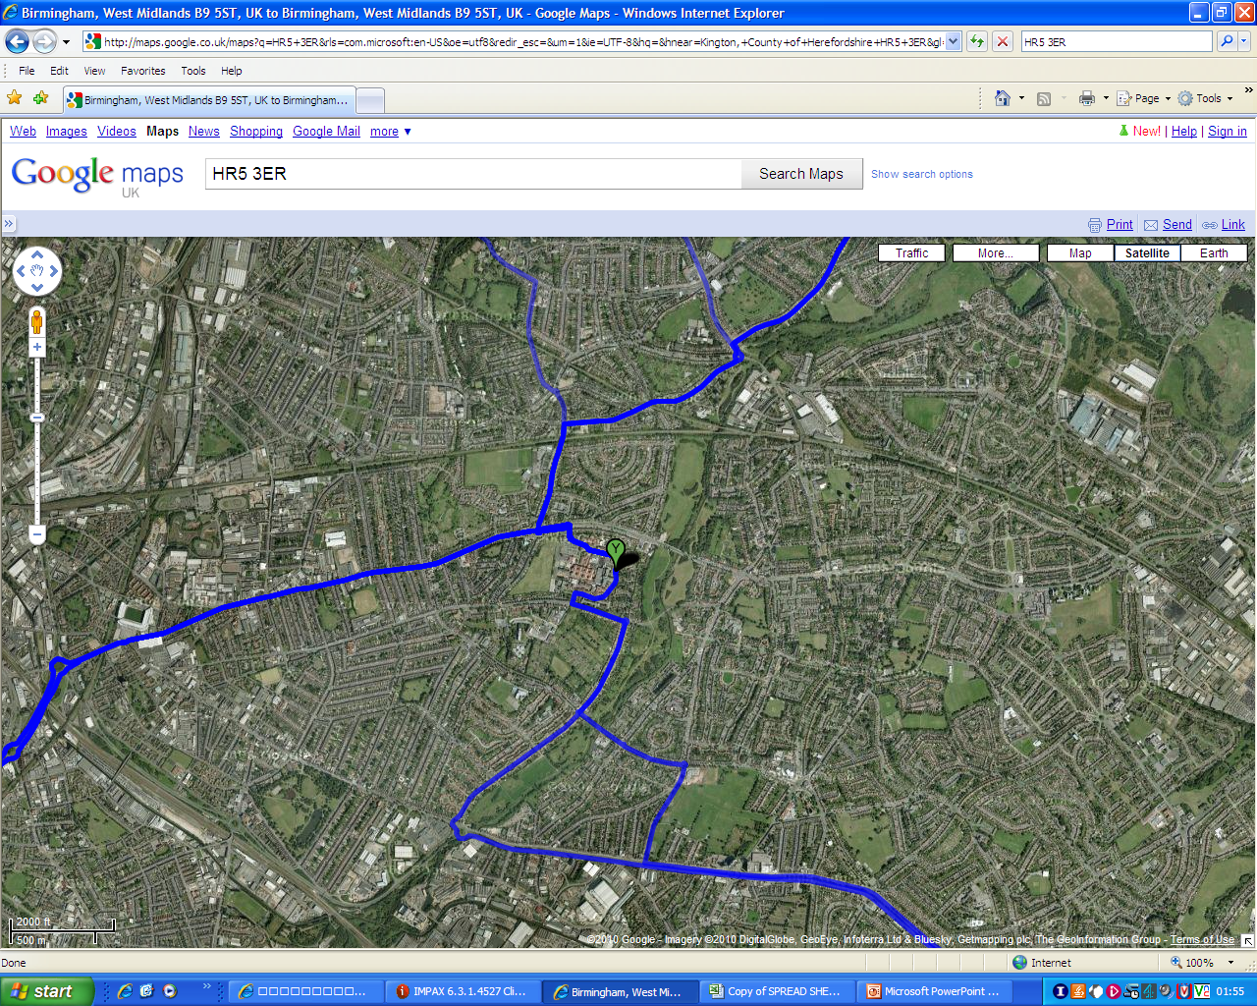

Slide 17
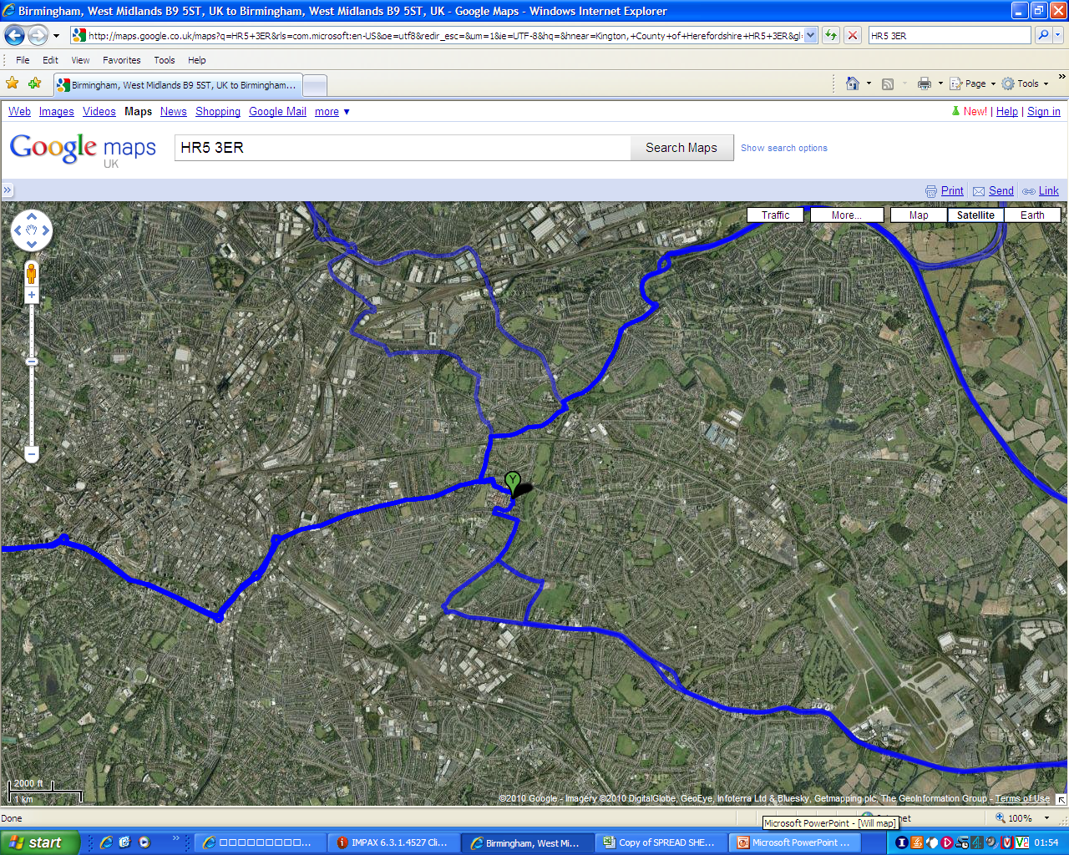

Slide 18
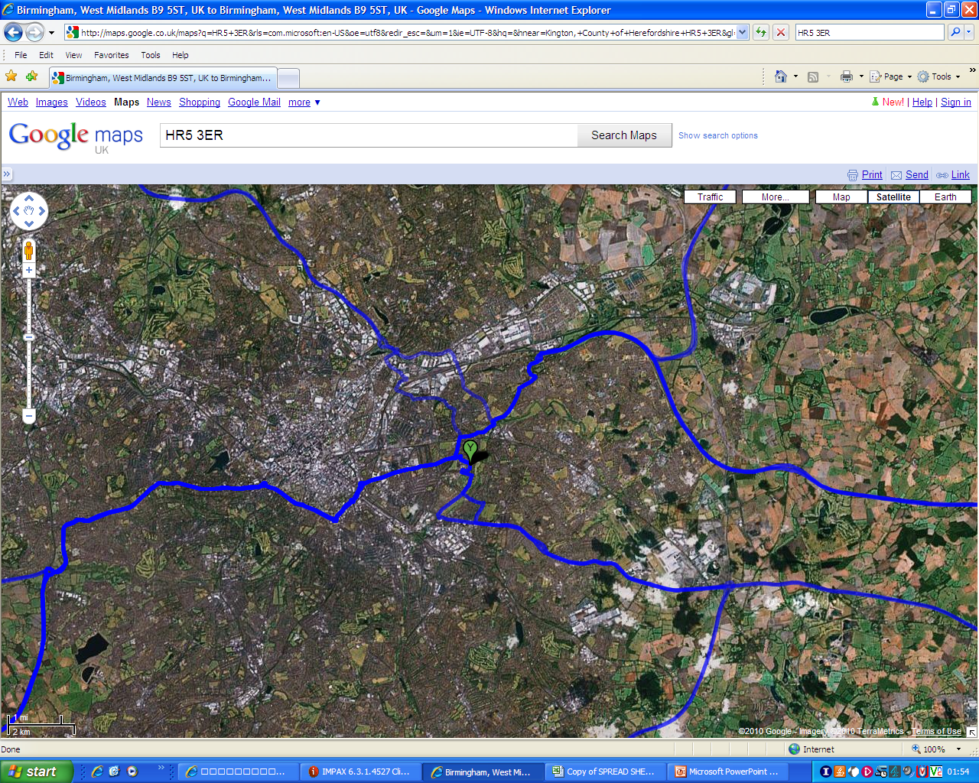

Slide 19
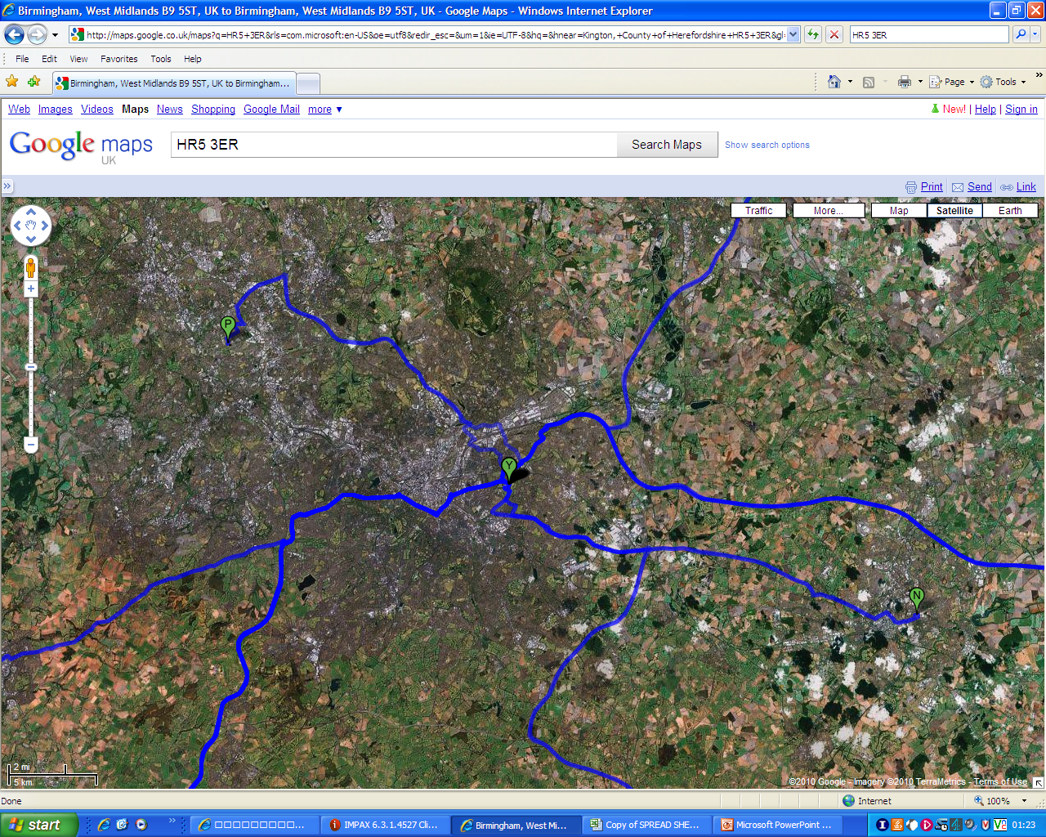

Slide 20
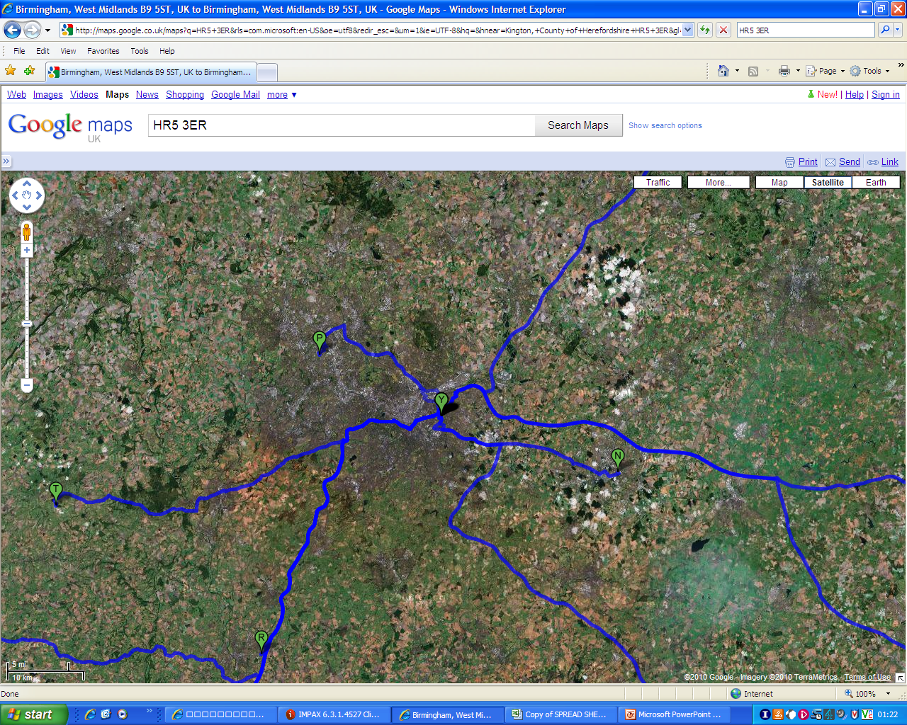

Slide 21
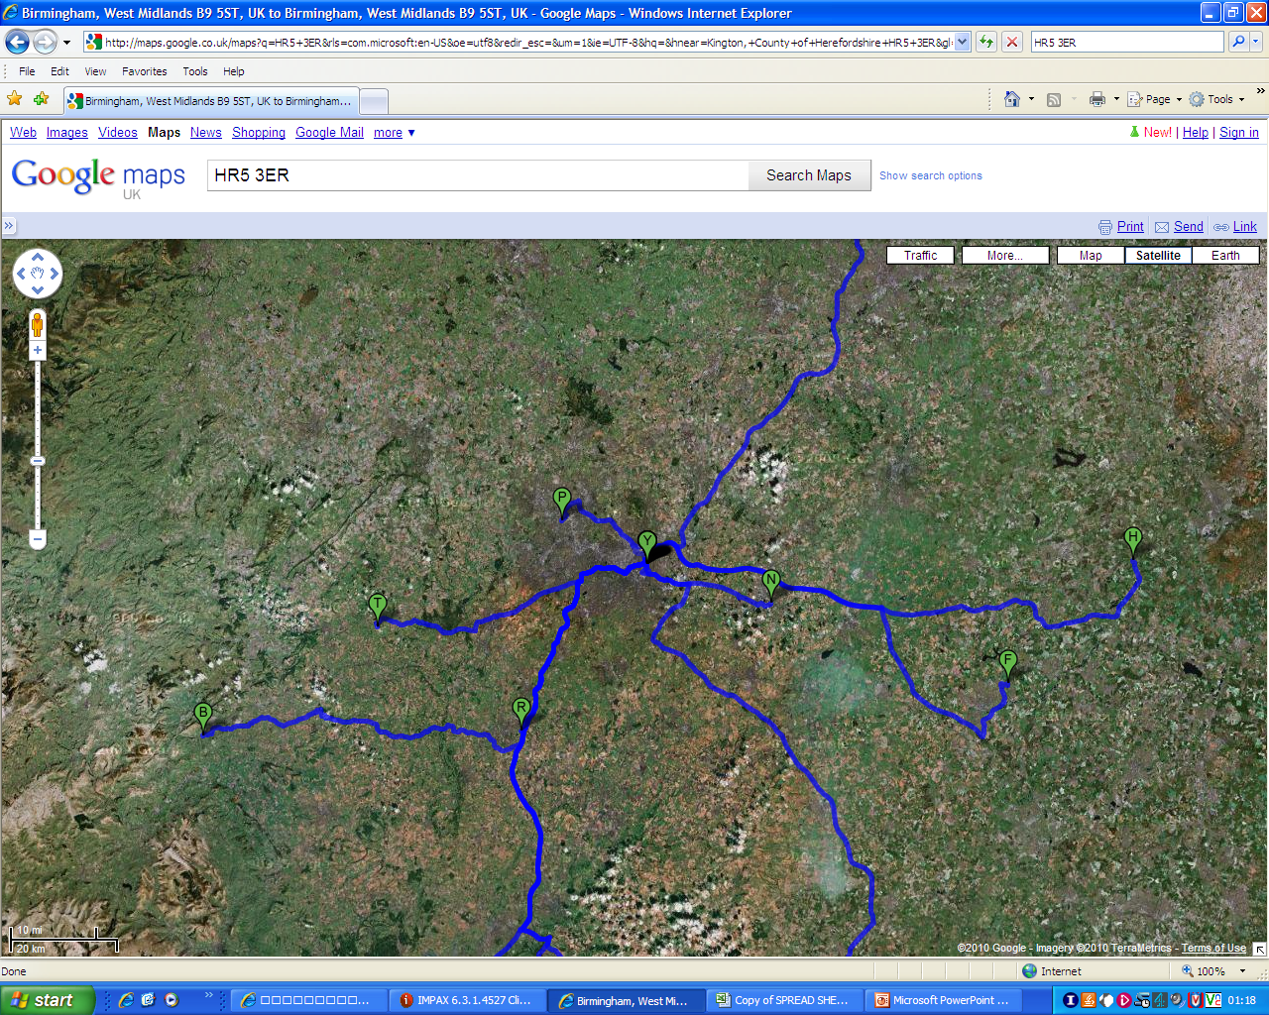

Slide 22
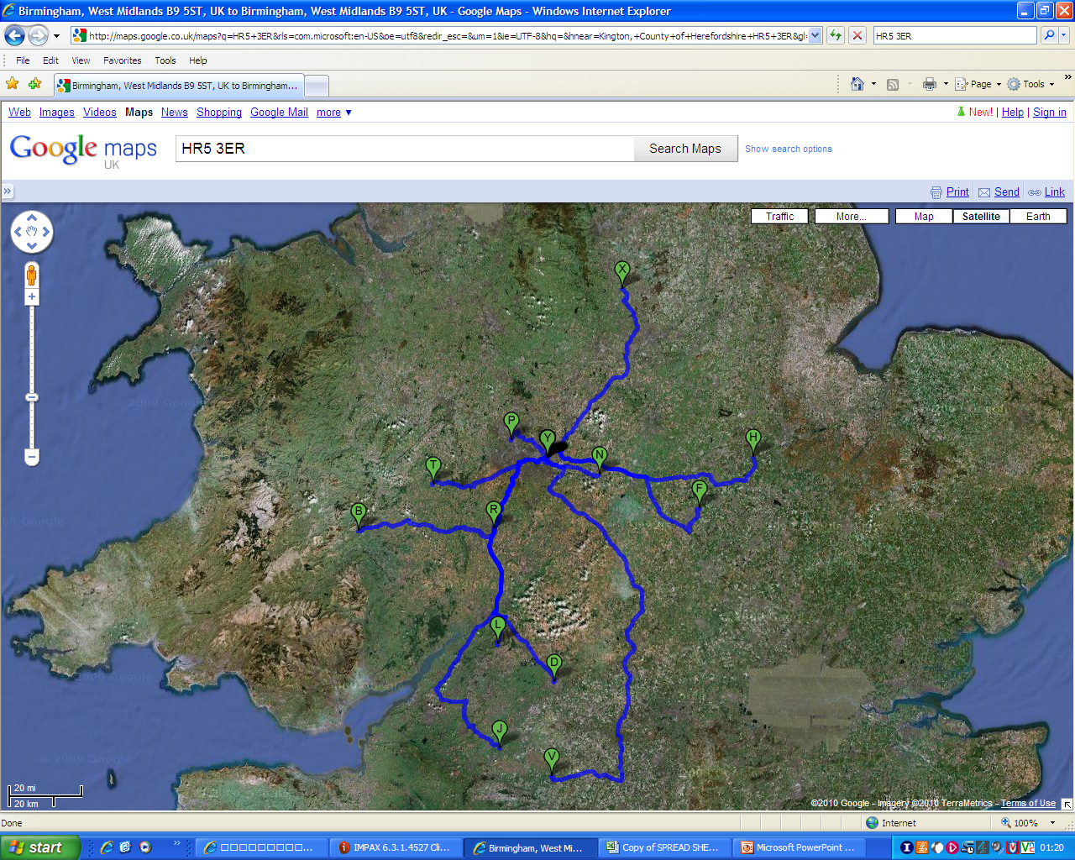

Slide 23
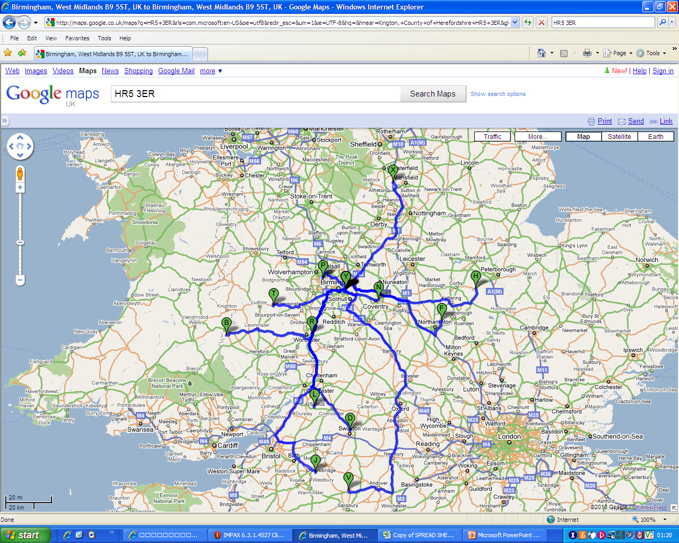

Slide 24
Aims
To see how far we are deviating from the RCSEng guidelines on BMI and travelling time
To demonstrate that despite this, we are providing safe surgery and peri-operative care to our patients

Slide 25
Methods
Retrospective audit of prospectively collected data
Patients discharged as a day case after laparoscopic gastric banding in our unit
January – August 2009
BMI recorded on admission
Travelling time derived from patient’s postcode and AA routeplanner website
Record of post-operative telephone call used to assess primary outcomes
Early post-operative morbidity
Immediate readmission rates

Slide 26
Results – Body Mass Index
n = 129
100% of patients breech the RCSEng guidelines
Range 37 – 83 (Weight 88 – 260kg)

Slide 27
Results – distance/time to hospital
Distance
Travelling time
n = 129
47% of patients exceed the recommend maximum travelling time of 60 minutes
Mean travelling time 65 minutes (range 1-200 minutes)

Slide 28
Results - morbidity
Nausea – 2 patients
Mild dysphagia – 1 patient
All managed conservatively at home
No readmissions to hospital (Heartlands or their local hospital)

Slide 29
Conclusions
Day case laparoscopic gastric banding can be performed safely, irrespective of where the patient lives or their BMI
These findings can be generalised to other day case procedures
From our experience we believe that the drive towards a high day case rate has also led to an improvement in our surgical and anaesthetic standards
Constant review of our technique
Standardised patient/theatre set up
Efficiency of movement
Ensure operative field is totally dry
Short acting anaesthetic agents
Avoidance of opiates
Liberal use of antiemetics

Slide 30
Conclusions
We therefore suggest that the 18 year old recommendations on Day Case Surgery from the Royal College of Surgeons of England should be revised in line with modern and laparoscopic practice

Slide 31
Day Case Bariatric Surgery – Time to Revise the Guidelines from the Royal College of Surgeons of England
W Hawkins, S Khan, M Seenath, P Super
Heartlands Hospital, Birmingham

