Slide 1
Evolution and future of day case hand surgery in Portsmouth
Deborah Marsh, Consultant Anaesthetist
Alan Stedman, Consultant Anaesthetist
Sophie Phillips, Consultant Orthopaedic Surgeon
British Association of Day Surgery, June 2010

Slide 2
The Ideal Day Case Anaesthetic
Safe
Allows rapid list turnover
Allows good operating conditions
Effective post operative analgesia
Low requirement for unplanned admission
High patient satisfaction

Slide 3
History of Hand Surgery in Portsmouth
Team started in 2002 – GA in-patient list
DM and YK – started to use brachial plexus blocks, combined with GA, for post operative analgesia

Slide 4
History of Hand Surgery in Portsmouth
Mostly Vertical Infraclavicular Block (VIB) using a nerve stimulator
Increase in day case patients
Key factor – interest and encouragement from surgeon

Slide 5
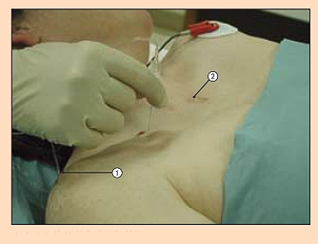
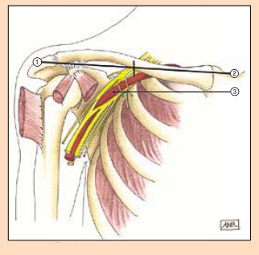
The VIB

Slide 6
History of Hand Surgery in Portsmouth
2006/2007
DM - sabbatical in Auckland, New Zealand
AS - regional anaesthesia fellowship in Perth, WA
Both exposed to ultrasound-guided regional anaesthesia

Slide 7
Ultrasound guided regional anaesthesia
On return DM started using a borrowed ultrasound machine for infraclavicular blocks
AS joined Portsmouth as a registrar keen to continue with ultrasound guided regional anaesthesia
Unwavering support from our surgical colleague

Slide 8
Ultrasound guided regional anaesthesia
Portsmouth in process of funding ultrasound for CVP insertion (NICE 2002)
IT also interested in US for RA
Obtained 2 Sonosite S-Nerve machines capable of achieving both functions

Slide 9
Advantages of US
Faster onset
Improved success rate
Improves patient satisfaction
Successful block without a nerve stimulator
Confirmation of LA spread
Confirmation of catheter placement
Detection of intraneural injection
Identifies other anatomy
Allows blocks not possible without US

Slide 10
Advantages of US
Faster onset
Improved success rate
Improves patient satisfaction
Successful block without a nerve stimulator
Confirmation of LA spread
Confirmation of catheter placement
Detection of intraneural injection
Identifies other anatomy
Allows blocks not possible without US

Slide 11
Advantages of US
Faster onset
Improved success rate
Improves patient satisfaction
Successful block without a nerve stimulator
Confirmation of LA spread
Confirmation of catheter placement
Detection of intraneural injection
Identifies other anatomy
Allows blocks not possible without US

Slide 12
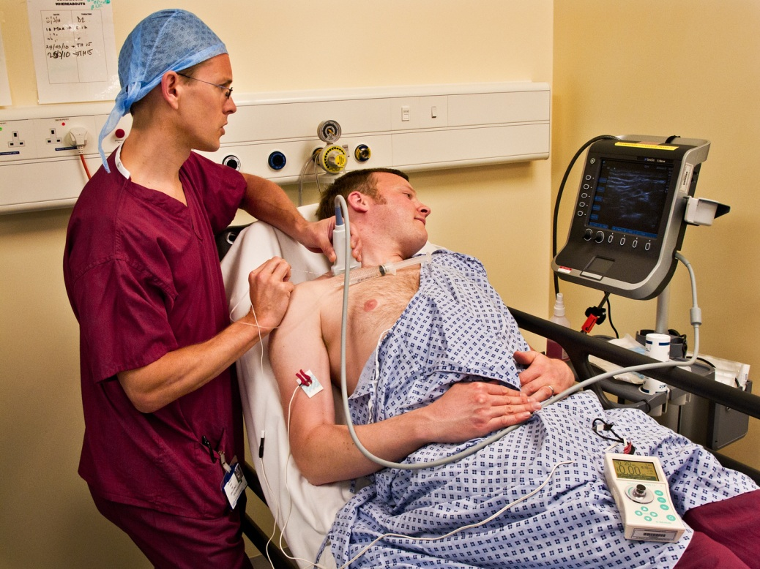
Supraclavicular block

Slide 13
Refinements
Short acting local anaesthetic
Prilocaine
Fast onset/offset
Rapid recovery of numb arm after discharge, increasing patient satisfaction and safety
Long acting local anaesthetic
Levo-bupivacaine
Peripheral nerve blocks

Slide 14
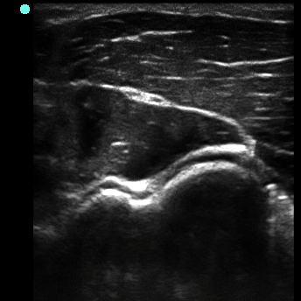
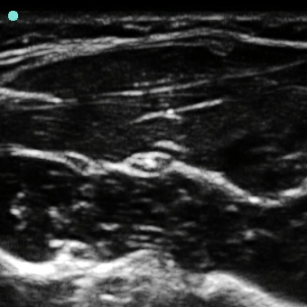
Peripheral Nerve Blocks

Slide 15
Post operative innovations
Increasing our use of nerve catheters to prolong duration of block and hence post op analgesia
Currently managed as in-patients but aim for day case in near future

Slide 16
Continuous perineural LA infusions
Prolonged analgesia after day case surgery
Reduced time to discharge
Reduced readmission rate

Slide 17
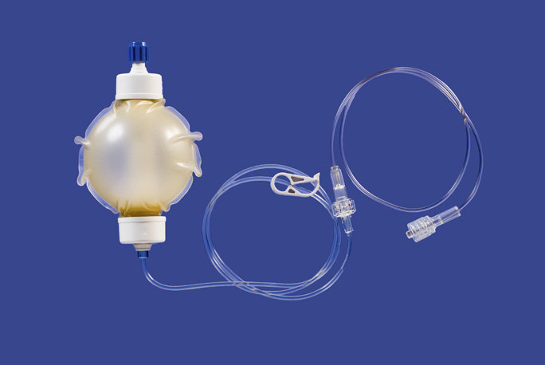
Portable infusion pumps
Range from simple disposable elastomeric pumps to more sophisticated mechanical battery operated
Complications rare
High patient satisfaction
Must have home care instructions
Back-up analgesia

Slide 18
Improving Patient Experience
Grant from Patient Experience Council to purchase an iPod and music
Increased patient information
pre-op and post-op information sheets

Slide 20
In summary

Slide 21
Happy Patients

Slide 22
The Team

Slide 23
Any Questions?

