Slide 1
Local anaesthesia Surgeons can do it !
Mr HS Khaira

Slide 2
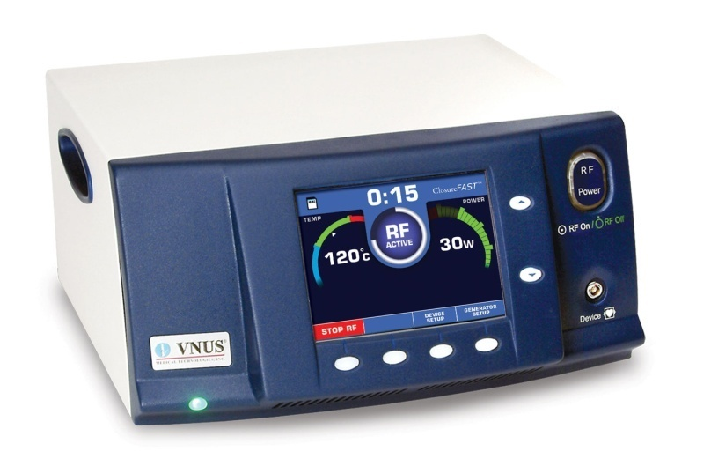
Varicose veins – VNUS Closure™

Slide 3
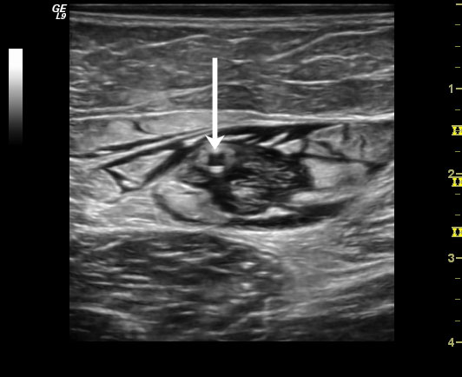
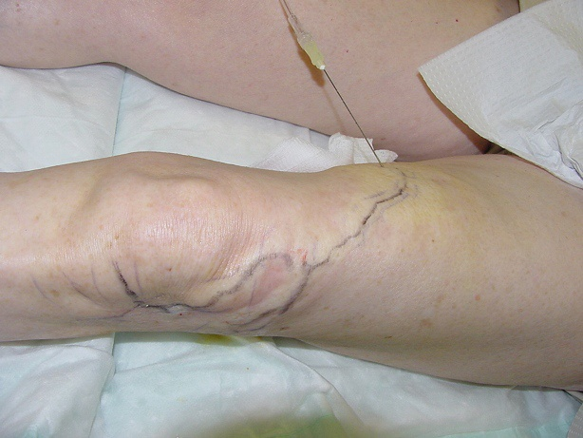
Varicose veins – VNUS Closure™
Tumescent anaesthetic (dilute and below toxic levels)
Ultrasound guided
Avulsions as well

Slide 4
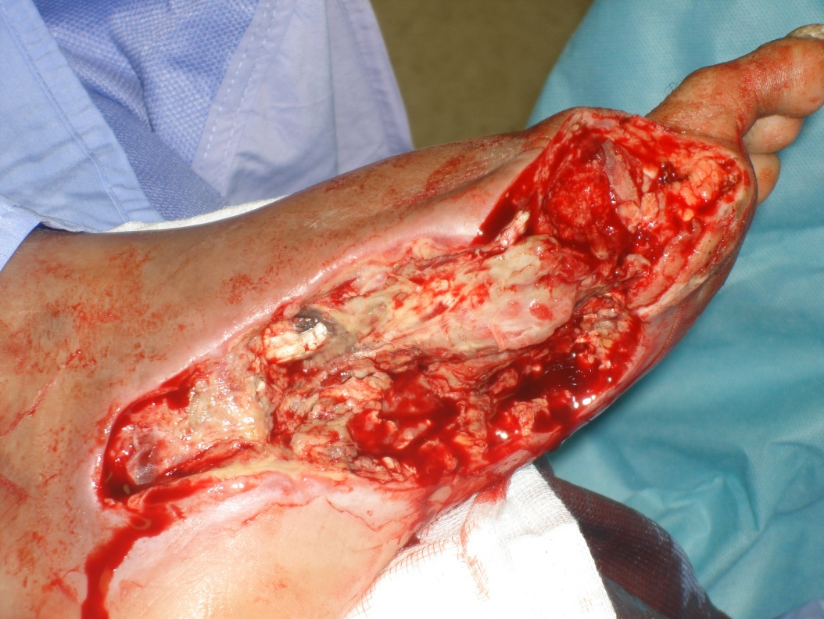
Diabetic foot
Toe amputation
Debridement
Digital block
Metatarsal block
Ankle block

Slide 5
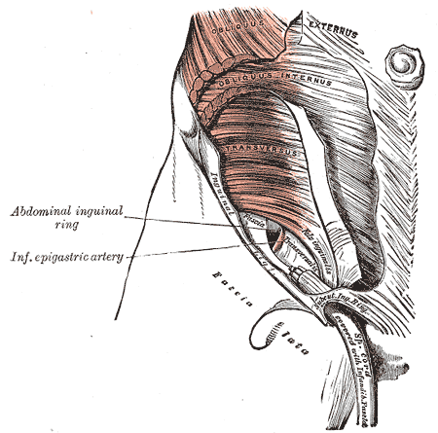
Hernia repair
Nothing new
Try it and see the difference
Courses – speak to Ethicon
Consider using USS for ilio-inguinal and ilio-hypogastric nerve block

Slide 6
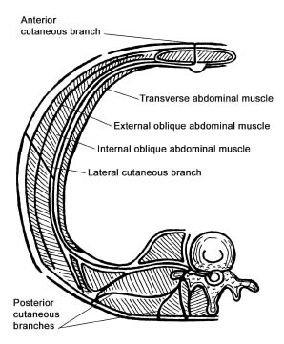
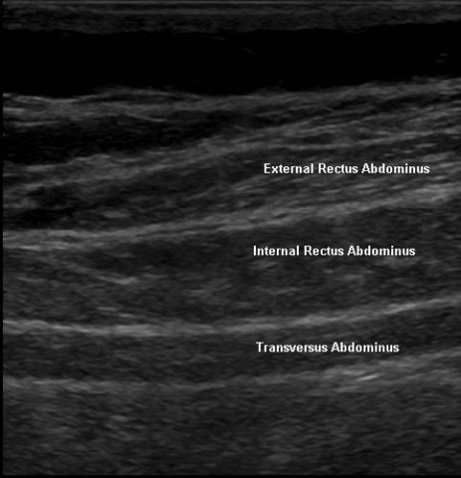
TAP Block

Slide 7
TAP Block
Lap inguinal hernia
Lower abdominal lap incisional hernia
Open surgery
Ultrasound guided

