Slide 1
This house believes that staggered admission times should be introduced for all day surgery patients
BADS June 2010 G.McCarthy

Slide 2
HSSB
BHSCT
BADS
Notes:
I would like to thank the organisers for inviting me along to speak in this debate today. Before we get started I think it wise that I indicate that the views I express are not those of these organisations I am associated with, nor BADS for that matter.

Slide 3
Notes:
I think when considering these issues its important to see things clearly because things are not what they seem..
Anyway for the purposes of discussion I’m going to call the single admission system the ‘Big Bang’ and the staggered system the staggers…

Slide 4
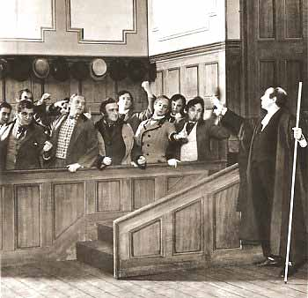
Monster! Monster! Dread our fury!
Notes:
Although this is billed as a debate – it is in fact a trial and you ladies and Gentlemen are the jury, I hope a little more lenient than this one. I couldn’t think of a better jury because you are doing what you do every day. This is not a question of the mindless application of protocols a 10 yr old could follow- no this is about judgement- the very thing you bring to your work everyday.
What we are judging is as old as the hills..

Slide 5
What is for the best……
Prioritise waiting on the Day of Surgery
Prioritise waiting on the Waiting list
Notes:
You own insight can tell you that this is seldom clear cut, and the answer is generally framed in terms of a rule of thumb. I am sure that Bill has or will show you cases where staggered admissions are appropriate but in general I will argue that is not the case
It is a question of priorities ..
Why should we care after all in a perfect world both systems would reduce the total of human misery..but of course the world isn’t perfect and that ladies and Gentlemen is where your judgement comes into play.
Now I am only going to talk about 3 things and I will end with taking you on a trip courtesy of Doug’s check book, so lets get started

Slide 6
1. Choice
Notes:
First I would like to talk about choice and waiting..
We are all sold the prospectus that more choice is good but sometimes its not so easy, that’s why patients ask us what is for the best- what should I do ..
Of course when we ask people what they want- they will tell us that they don’t want to wait…

Slide 7
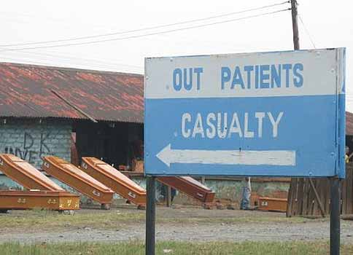
Notes:
And yet I am sure you have all worked in casualty..often people will wait hours for treatment when they could have had an individual appointment with their GP or other healthcare worker and yet folks wait because they would rather prioritise treatment today than wait for treatment tomorrow. In fact my GP friends tell me their busiest session is the drop in one were - folks come on a first come first served basis…so arguments against big bang admissions and patient choice are not as clear cut as they appear…

Slide 8
Just in time
Just too late
Notes:
IN the case of scheduling its easy to claim that staggered admission times are somehow human friendly in comparison to the Victorian big bang one size fits all technique of single admission times.
But I put it to you that it is exactly the opposite staggered admission times are in fact an expression of an industrial philosophy used to stack the supermarket shelves in one of the previous pictures..a philosophy known in the trade as Just too late..
In this philosophy people are like this…

Slide 9
Notes:
People behave like good industrial robots – turning up on time singly or in waves for processing….Of course we can say that this is people friendly because it minimises fasting times but that’s just confusing the issue-

Slide 10
Notes:
The experts on waiting

Slide 11
Notes:
Now I ‘ll be honest under either admission system the theatre is supposed to be working like this…
Which takes me to my second point..

Slide 12
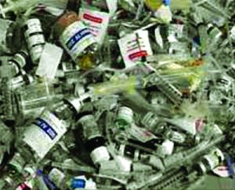
2. Waste
Notes:
Now everything is not about money, if it was you wouldn’t be working in the health service but we still have a duty to use what we have to best effect – which I think means prioritising the waiting list over waiting on the day..
Economists imagine a scenario in which We compensate a patient for waiting on the day…it’s a way of putting things in perspective..

Slide 13
It is 19 times more expensive to have the theatre wait
than to have the patient wait.
Notes:
This is the conclusion….Now above all times when the service is going to be stretched- when services and jobs may be on the line now is not the time for fuzzy thinking
Which takes me to my final section

Slide 14
3
Notes:
I don’t know which one of these guys is me or Bill but anyway I’d like to take you on a journey with me..to Monte Carlo or at least to the simulation technique

Slide 15
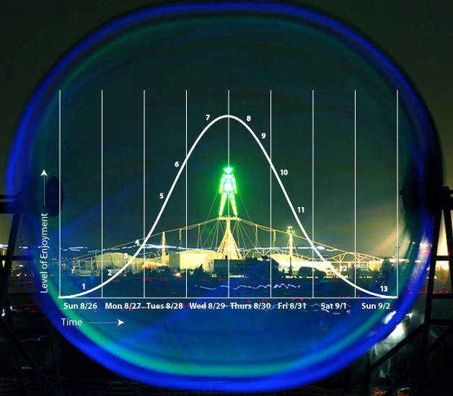
Notes:
So the there is a certain limited probability that the patient will not attend, then there will be a distribution of arrival times, followed by a distribution of Meeting and Greeting times, turnover times for the theatre, and a service time for the surgery itself..now the duration of surgery is not normally distributed but it is log normally distributed so I used that technique when I went to Monte Carlo..

Slide 16
Cystoscopy 11.6%
Cataracts 10.9%
Skin lesion 8.3 %

Slide 19
Notes:
We are all in for a rocky ride over the next few years -The economy has been stolen, services will need to be efficient to do the best for patients- I urge you to think clearly about scheduling

Slide 20
Notes:
Its your decision
Thank you.

